Slide 1
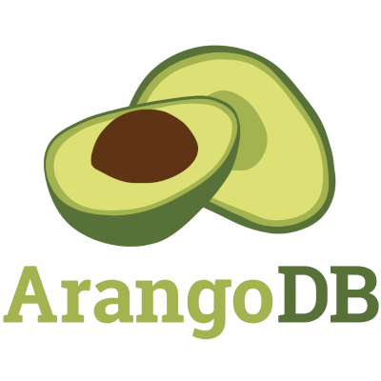
Multi-model database

Slide 2
Database Paradigms
Szybka powtórka

Slide 3
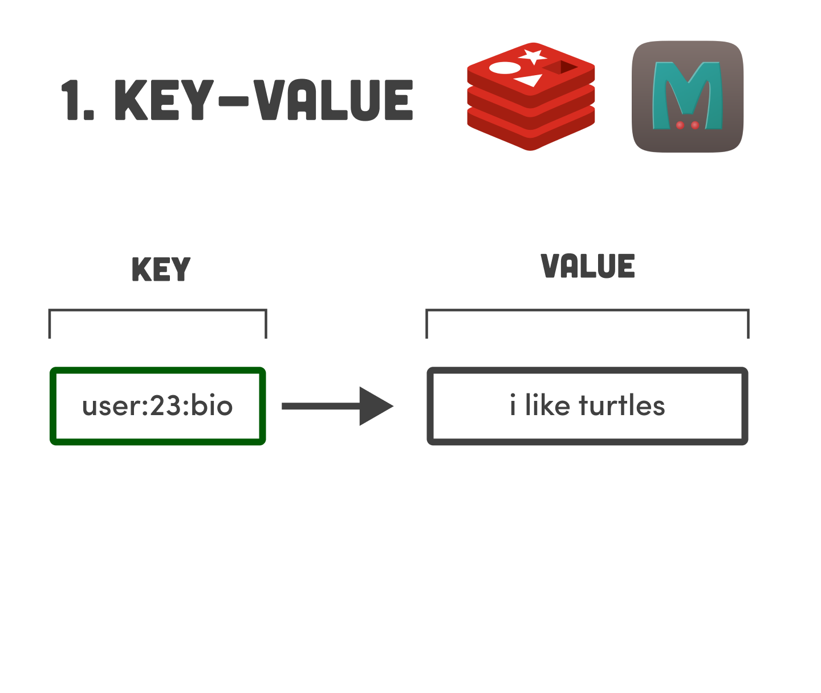

Slide 4
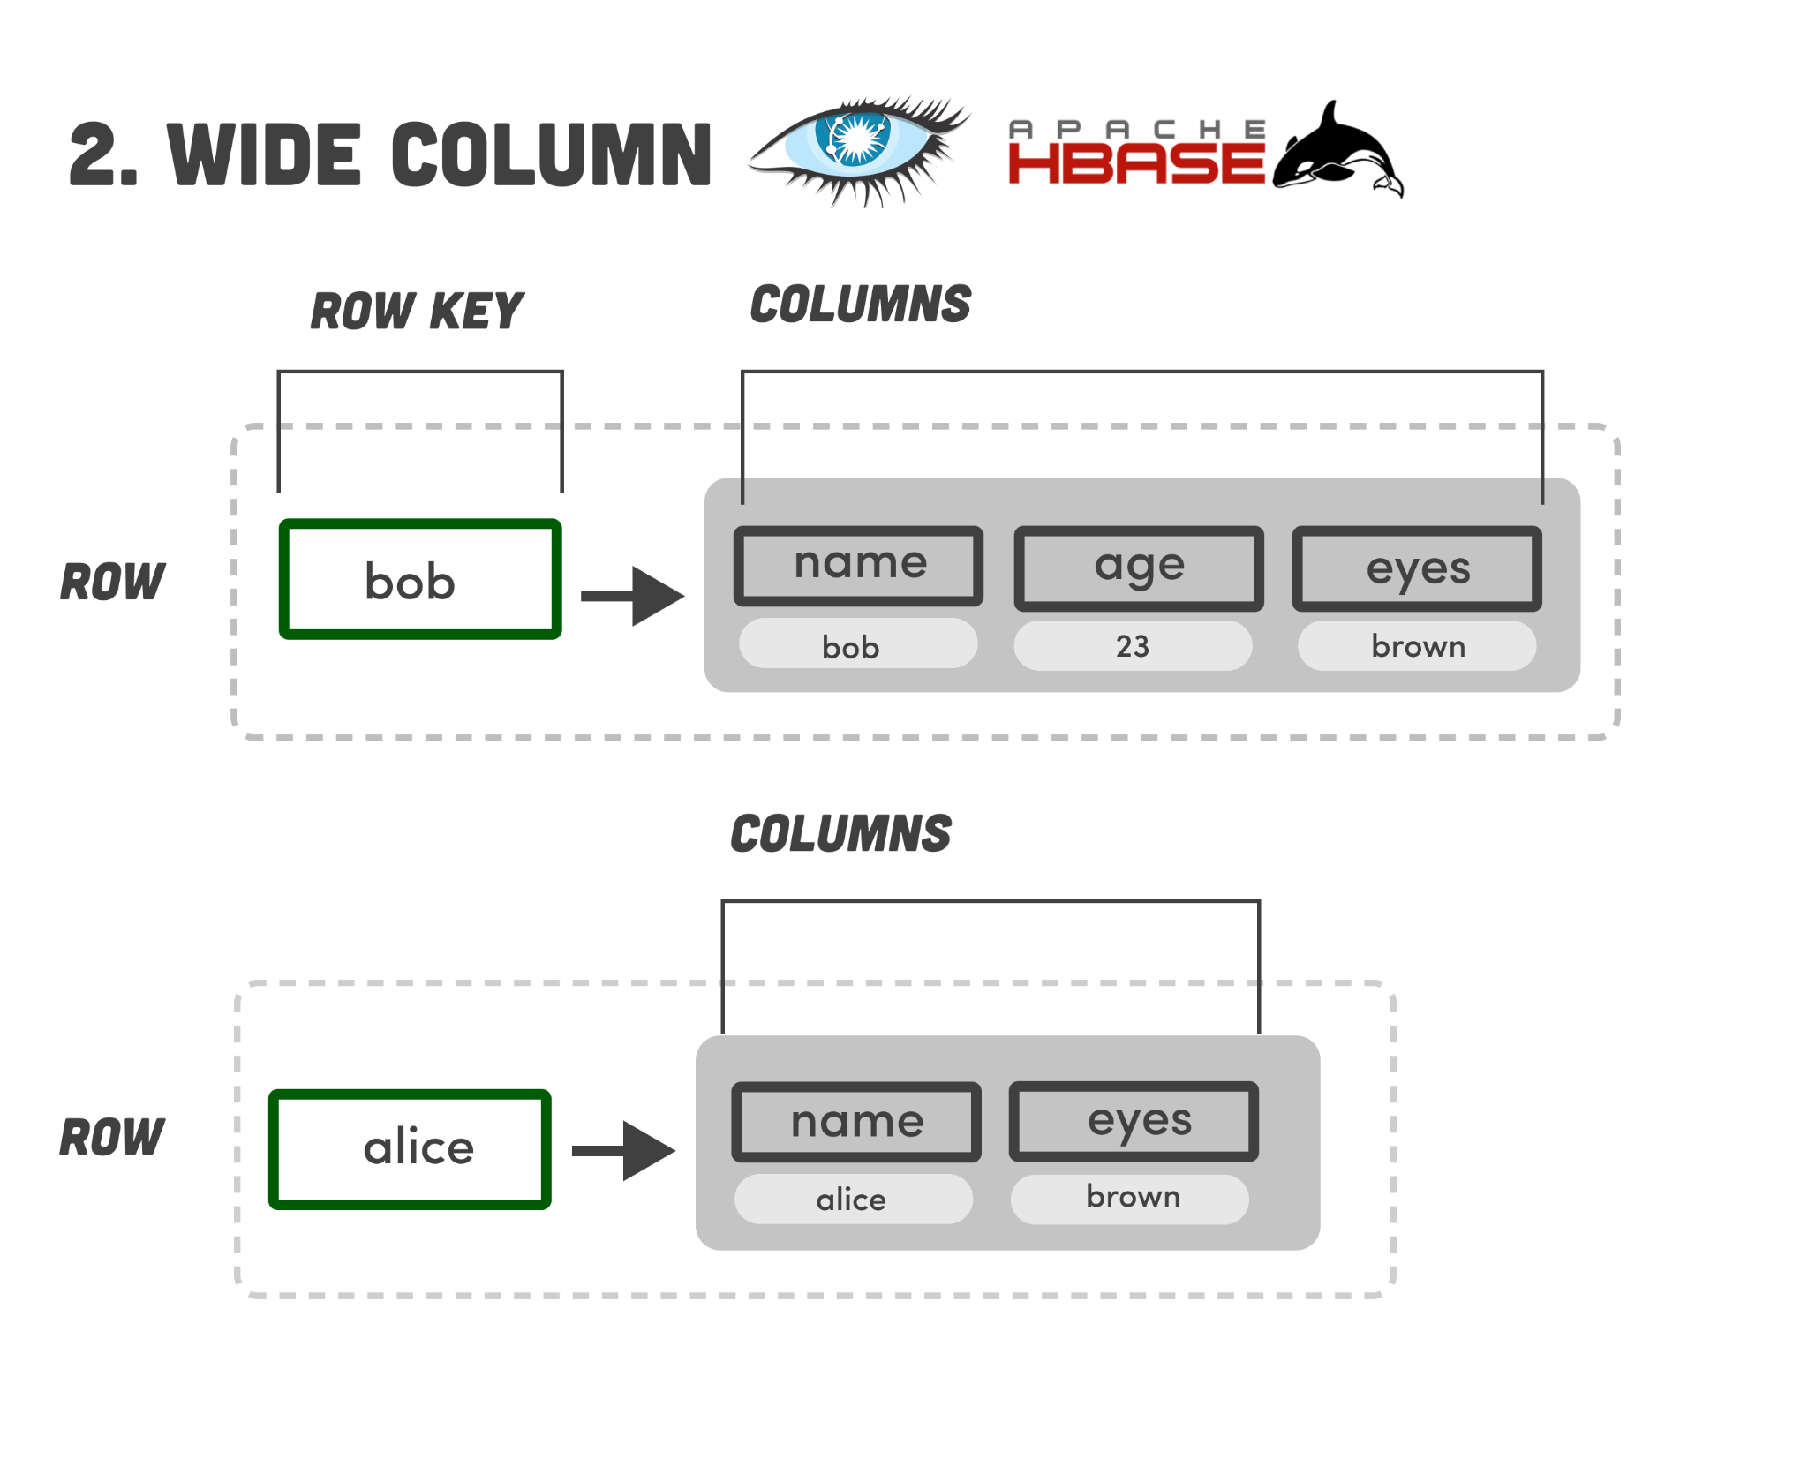

Slide 5
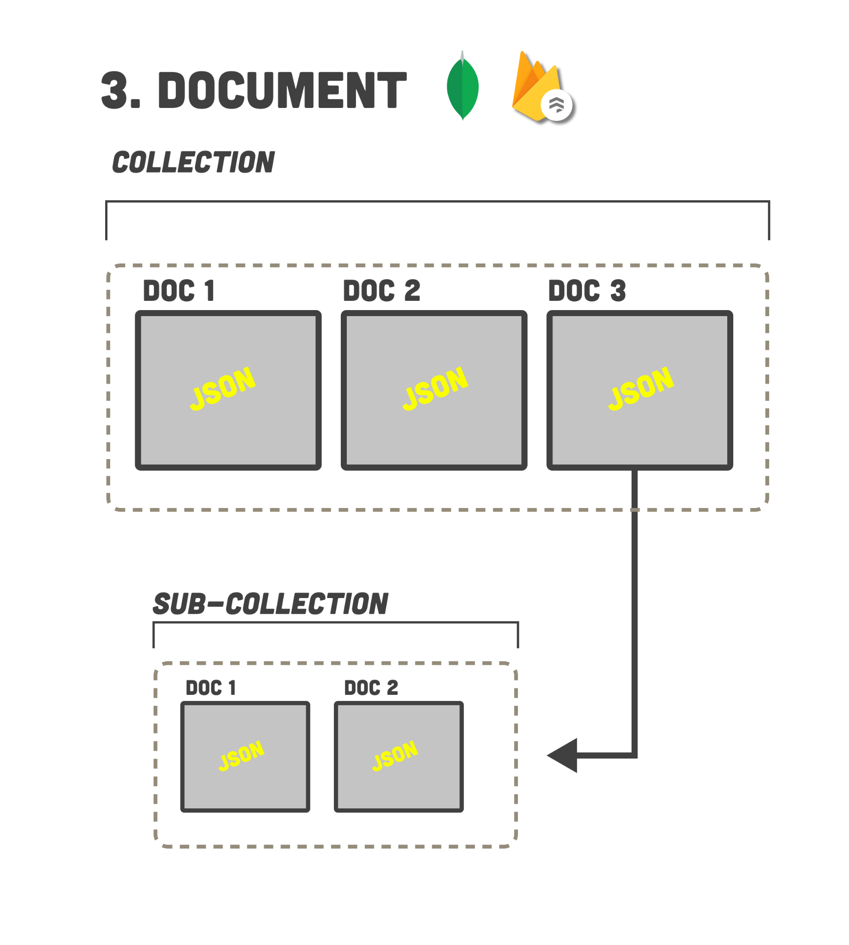

Slide 6
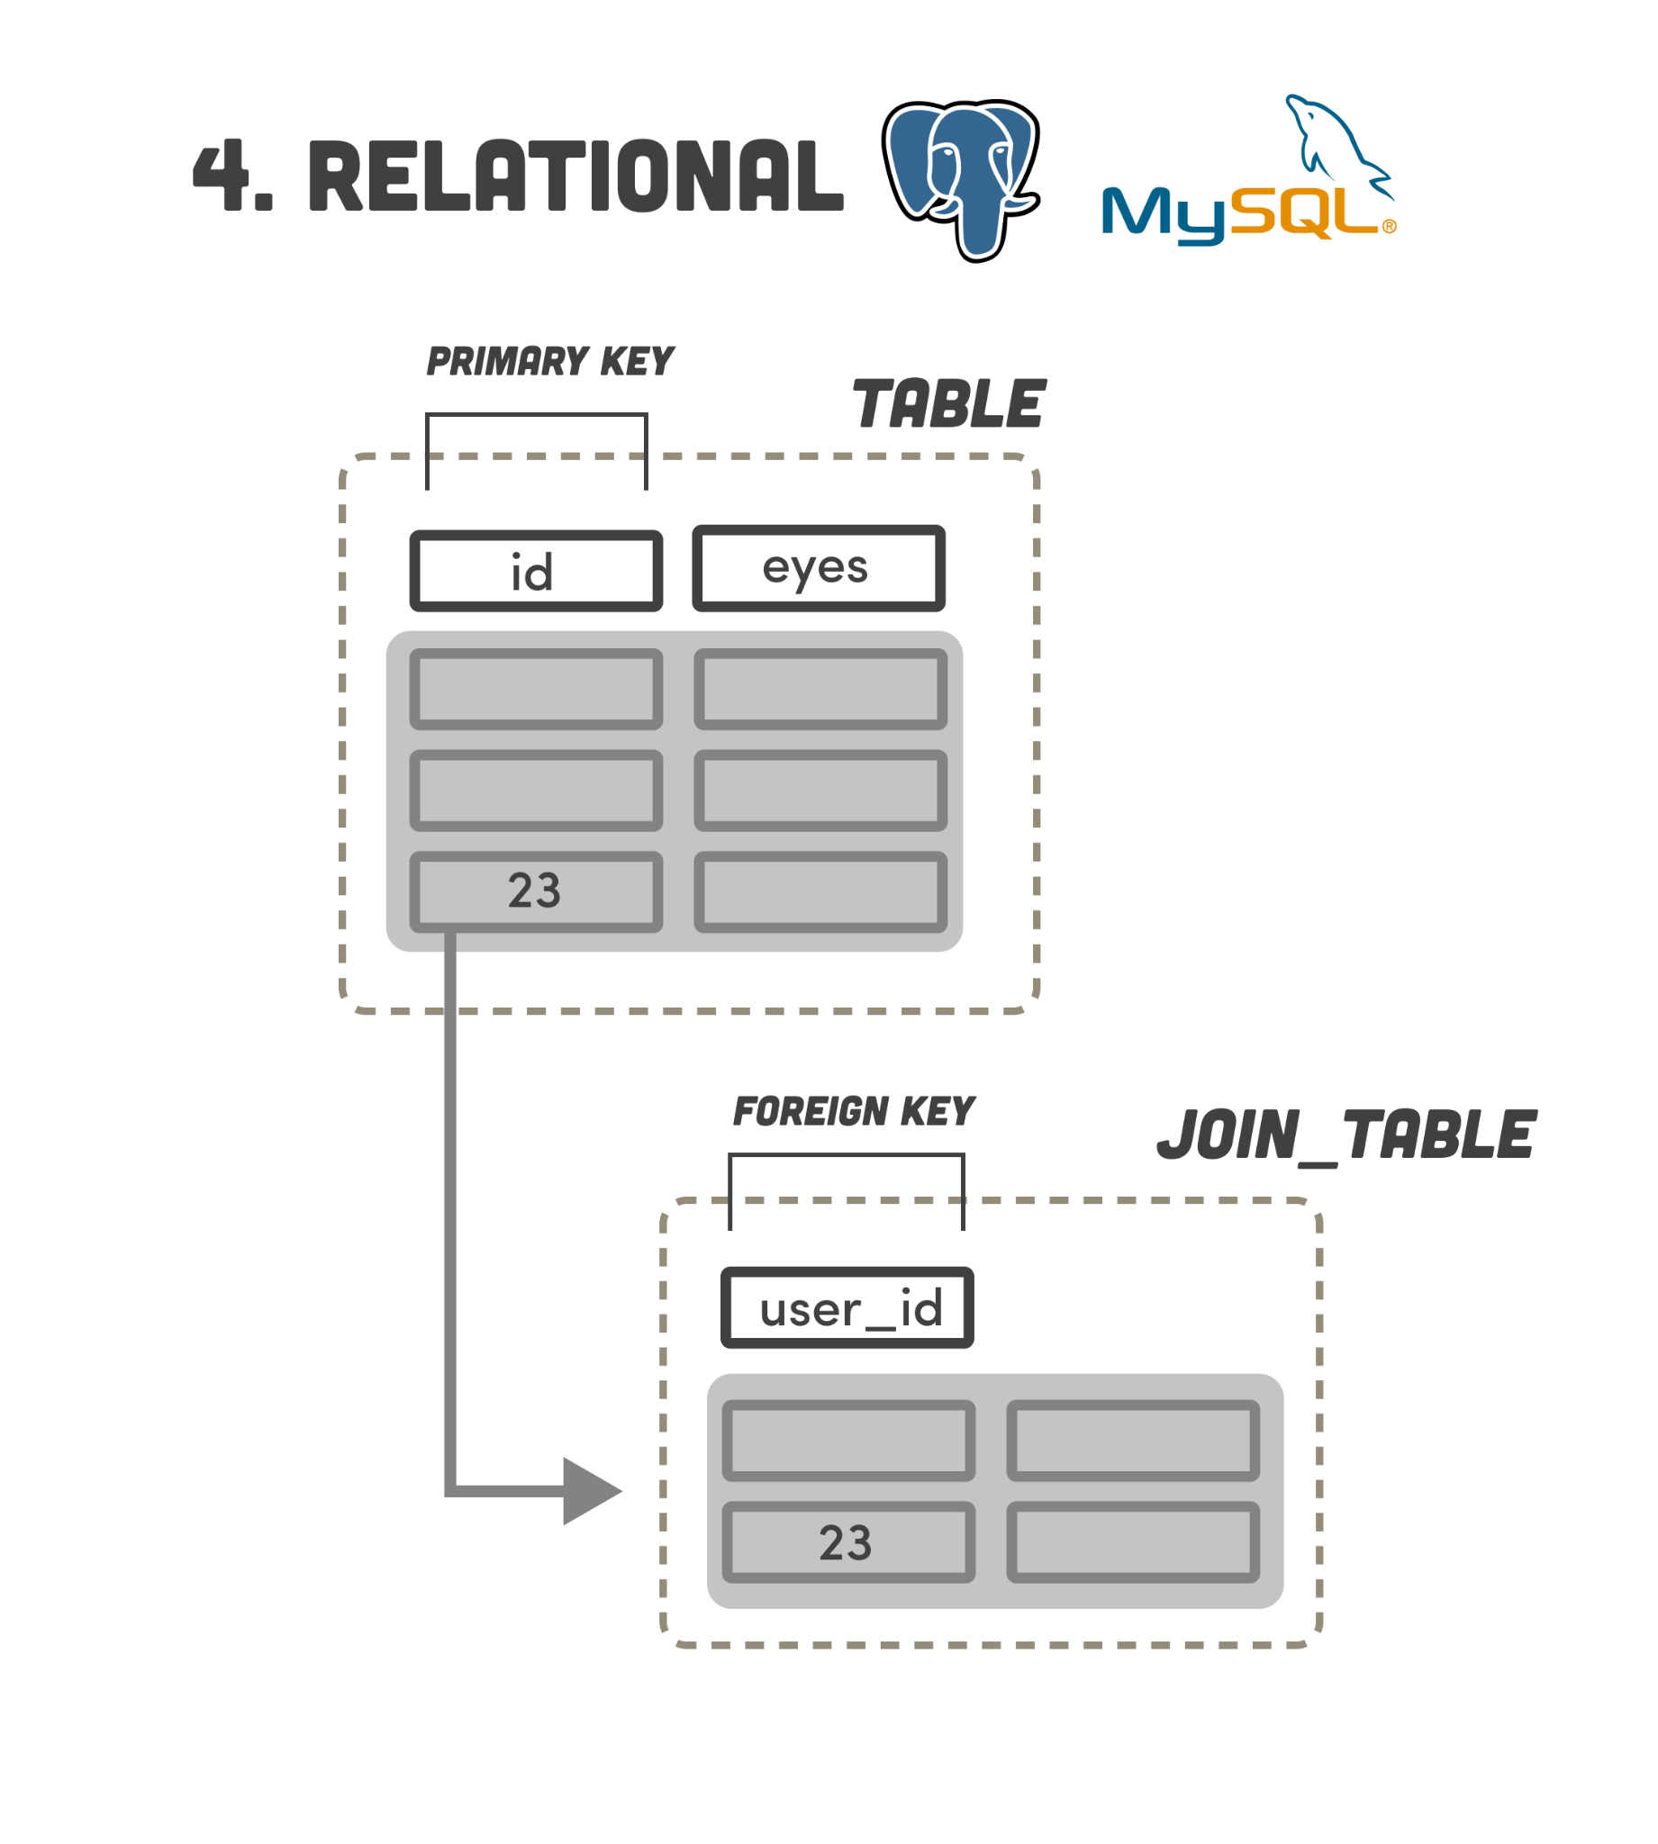

Slide 7
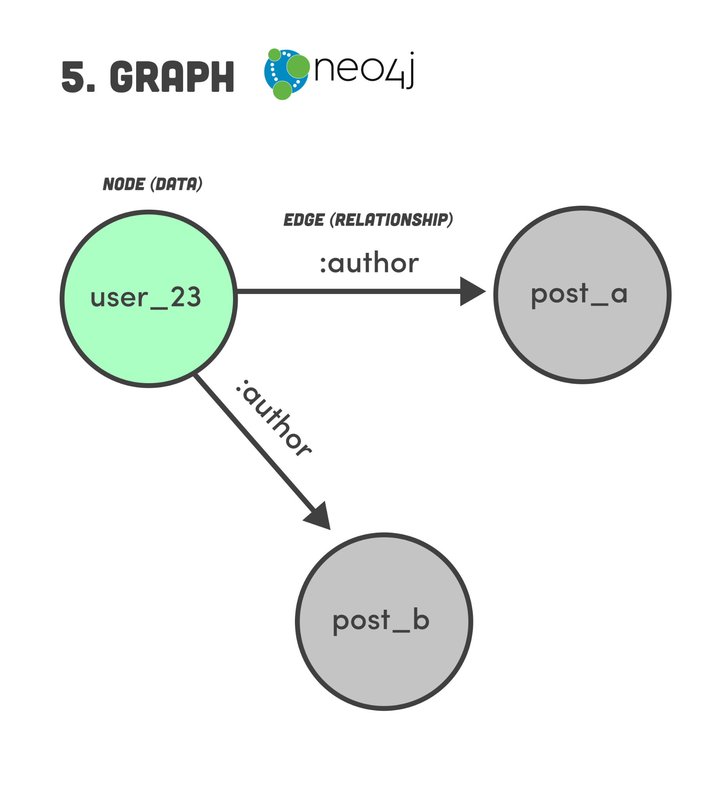

Slide 8
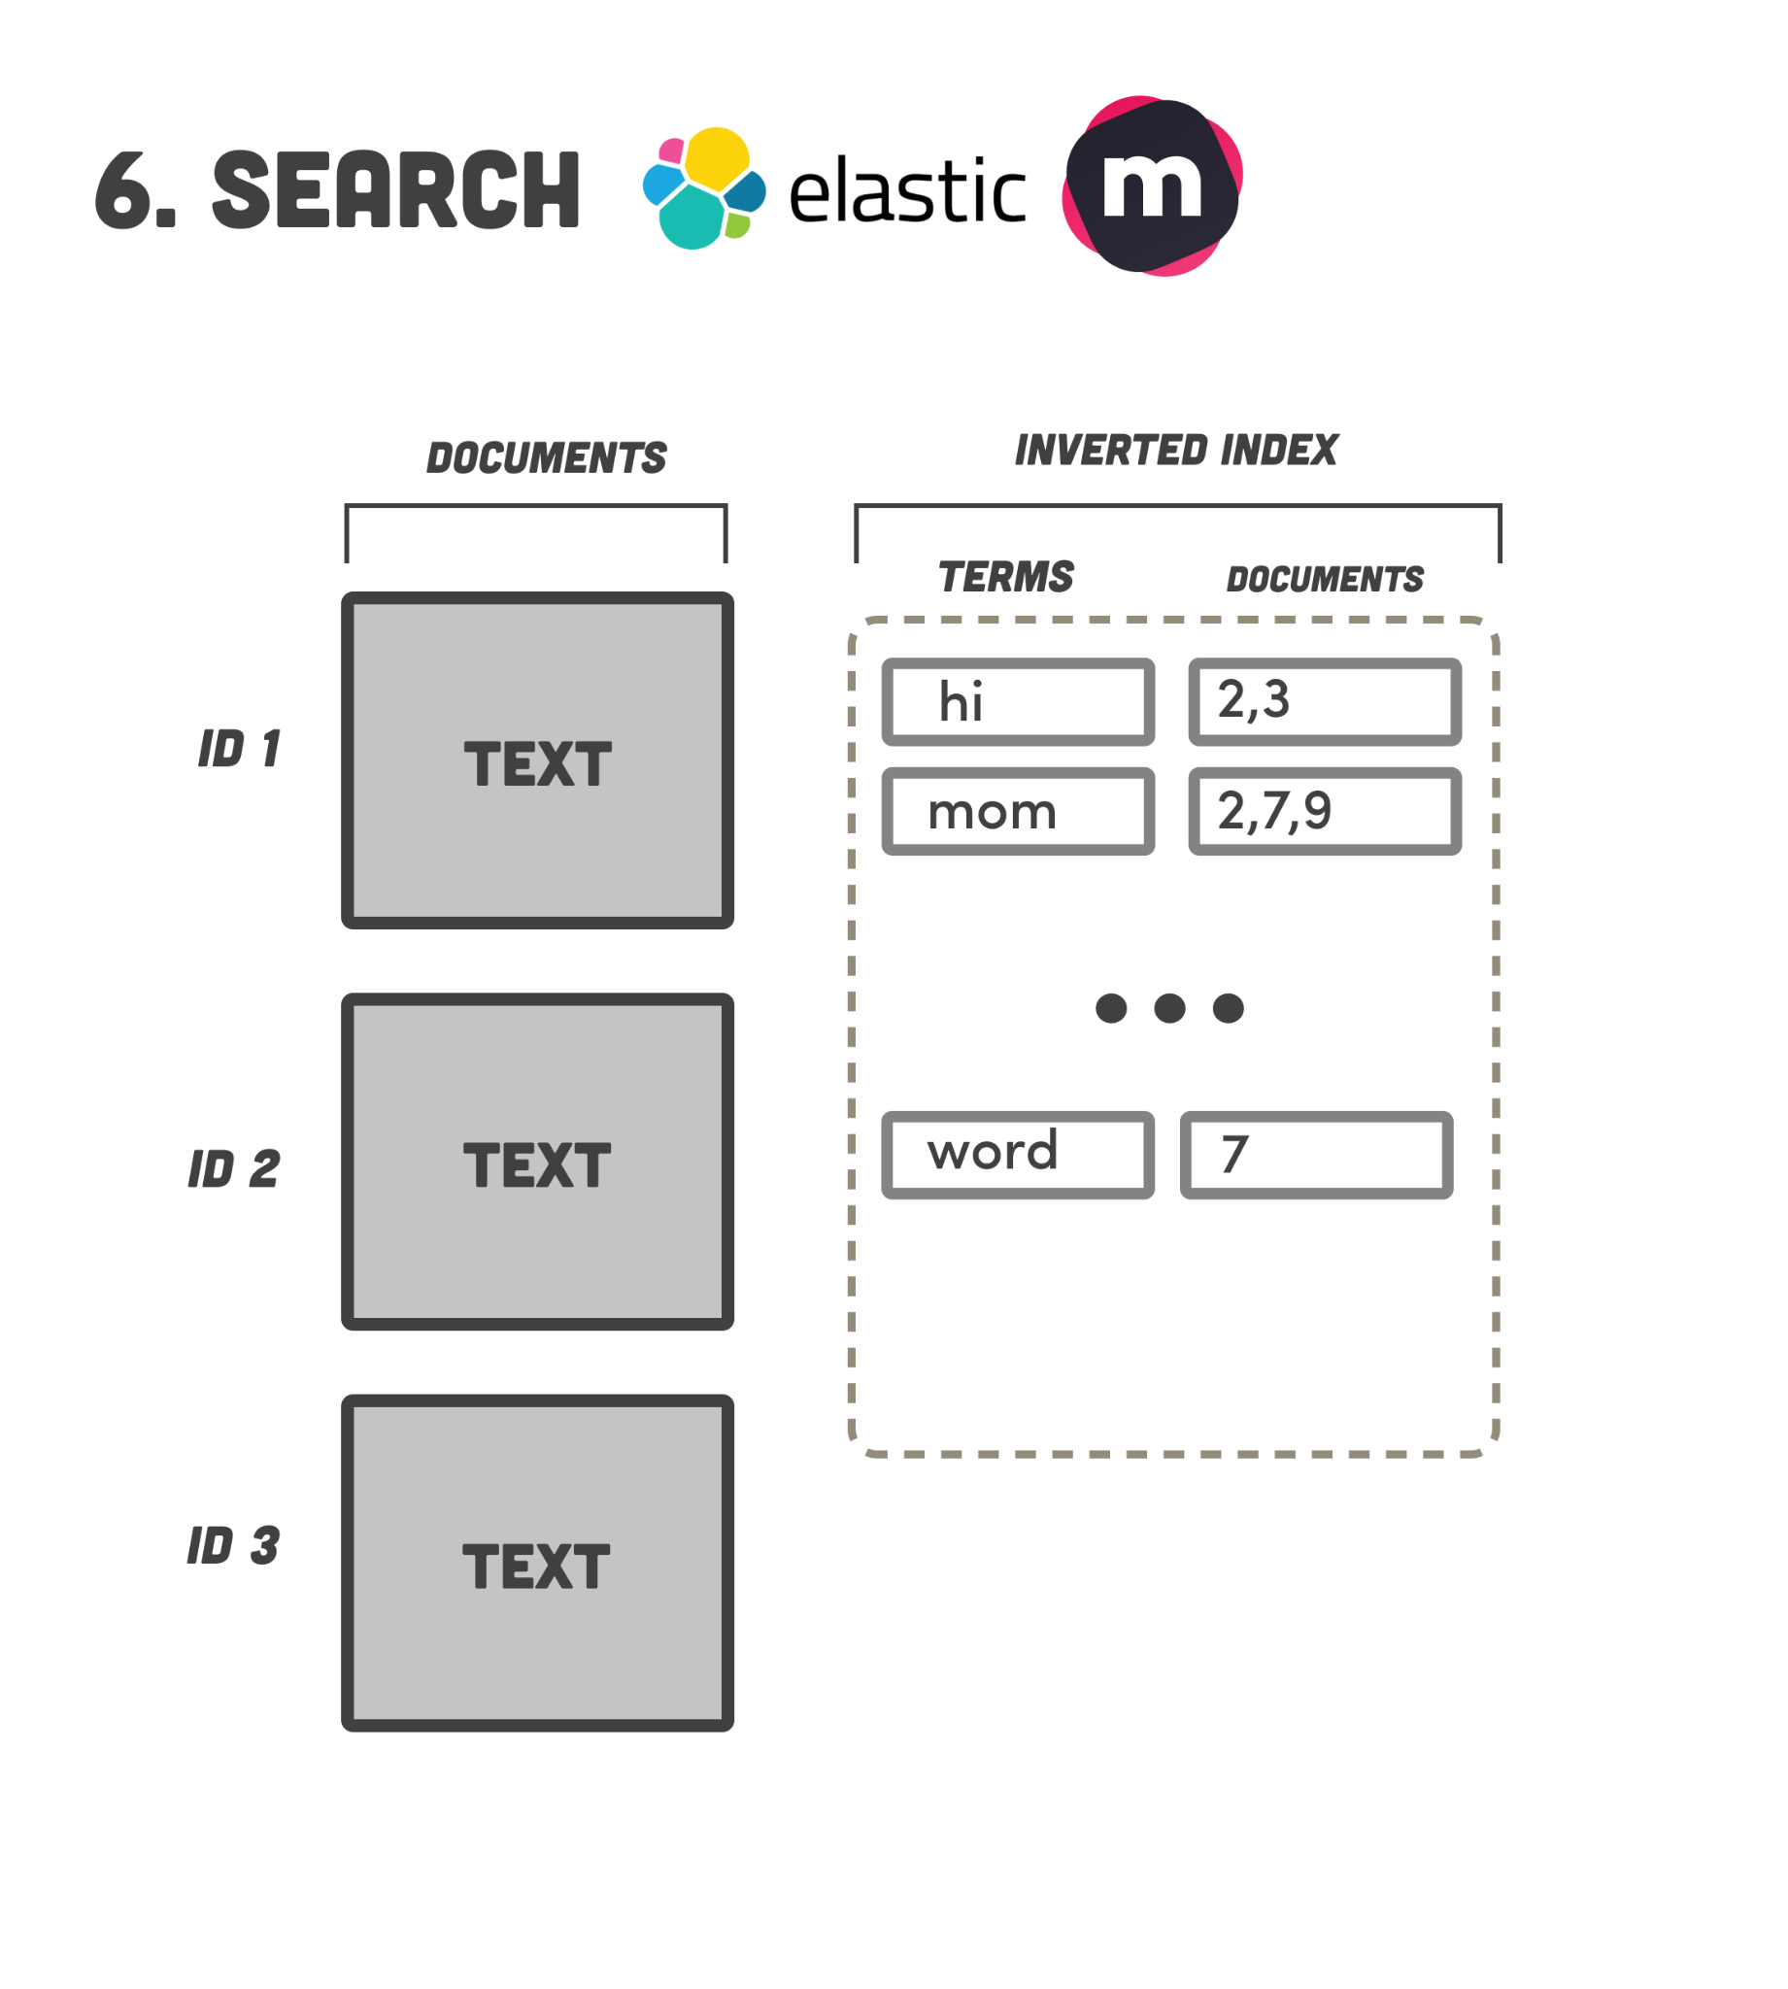

Slide 9
A teraz weź to postaw i utrzymuj

Slide 10
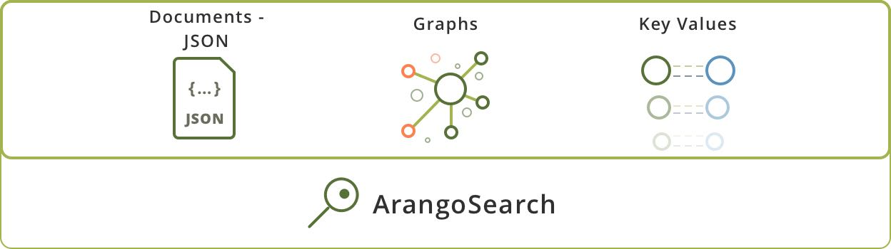
Po co mieć wiele baz jak można mieć jedna

Slide 11
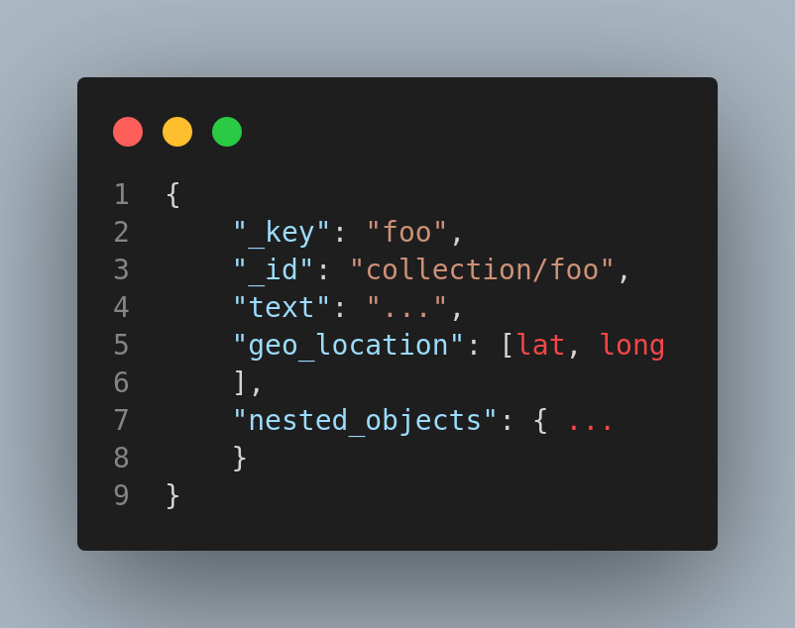
ArangoDB as a Document Database
All data in ArangoDB is stored as JSON documents and similarly structured documents that can be pooled into collections. Similar to a table in relational databases.
Work schema-free or use Schema Validation for data consistency. Store any type of data – date/time, geospatial, text, nested – and use ArangoDB’s feature-rich query capabilities to get the answers you want.

Slide 12
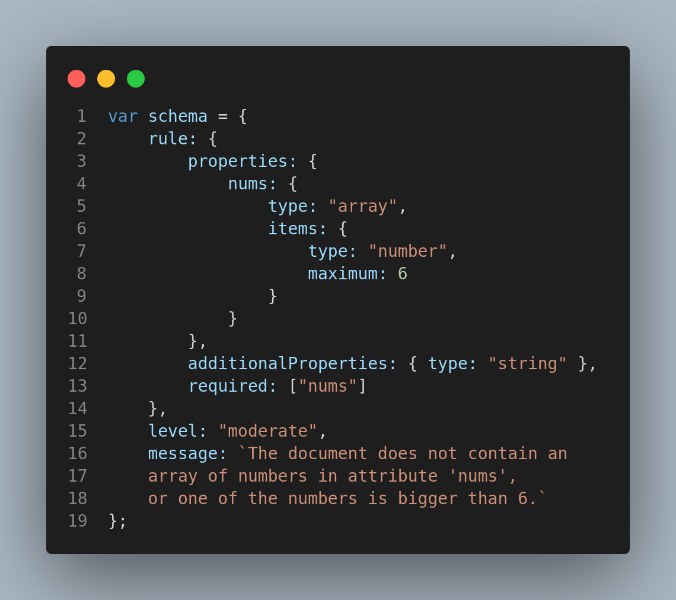
ArangoDB as a Document Database (Schema Validation)
Schema validation can be managed via the JavaScript API, typically using arangosh, as well as via the HTTP interface.
To enable schema validation either pass the schema property on collection creation or when updating the properties of an existing collection. It expects an object with the following attributes: rule, level and message.
- rule attribute must contain the JSON Schema description. - level controls when the validation will be applied. - message sets the message that will be used when validation fails
The level controls when the validation is triggered: - none: The rule is inactive and validation thus turned off. - new: Only newly inserted documents are validated. - moderate: New and modified documents must pass validation, except for modified documents where the OLD value did not pass validation already. This level is useful if you have documents which do not match your target structure, but you want to stop the insertion of more invalid documents and prohibit that valid documents are changed to invalid documents. - strict: All new and modified document must strictly pass validation. No exceptions are made (default).

Slide 13
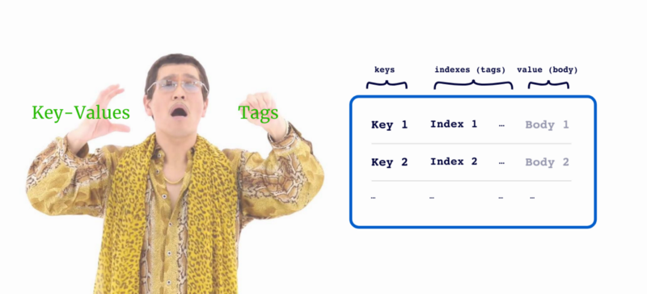
ArangoDB as a Key/Value Store
ArangoDB also provides the characteristics of a modern, distributed key/value store. By just storing the document key and a value within a JSON document, some typical key/value operations like CRUD or range queries can be performed efficiently.
To support all the other data models natively, ArangoDB has to store more attributes compared to a “classical” key/value database. Due to this additional overhead, we don’t recommend ArangoDB for key/value use cases which require hyper-scale. A second difference from classical key/value stores is that ArangoDB is not optimized for blob storage (i.e., binary large objects like image files).

Slide 14
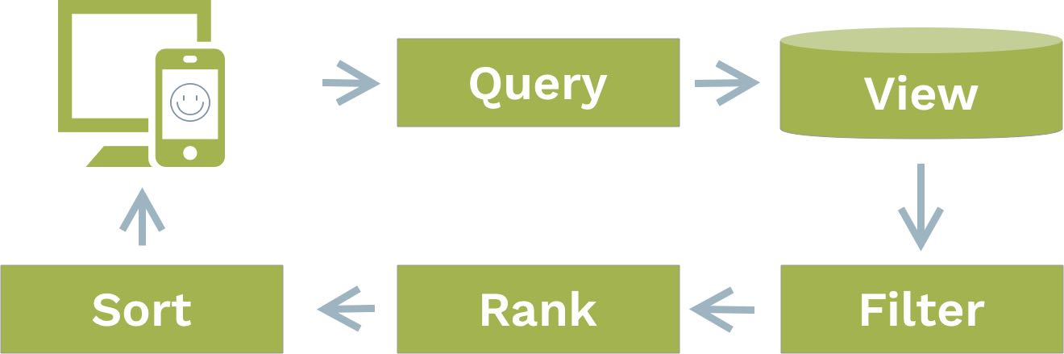
ArangoDB as a Search Engine
- Feature-Rich, Accurate & Ranked Search
Perform highly efficient search with C++ based ArangoSearch. Use many query types spanning phrase, wildcard, proximity, range and much more. Rank your results by similarity using BM25 or TFIDF algorithms.

Slide 15

ArangoDB as a Search Engine
- Feature-Rich, Accurate & Ranked Search
- Provide Search for Everyone
ArangoSearch supports already 30 languages including English, most european languages and also Chinese. Use dedicated language analyzers, stemming and stopword removal for fast and efficient search in all supported languages.

Slide 16
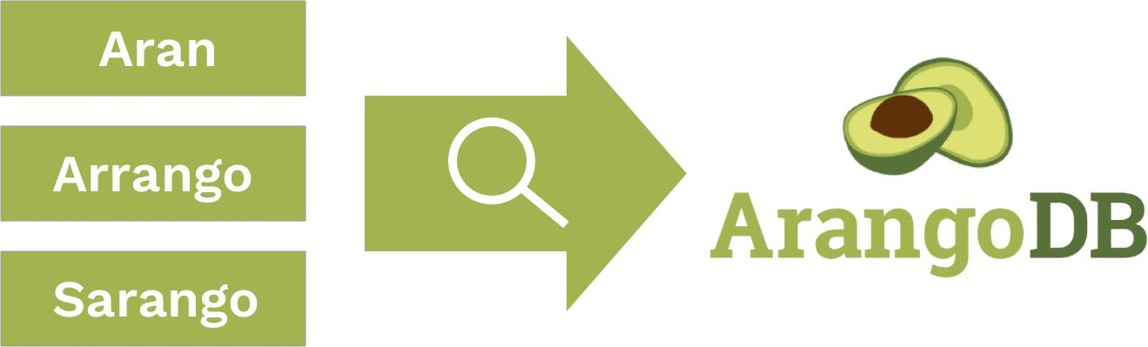
ArangoDB as a Search Engine
- Feature-Rich, Accurate & Ranked Search
- Provide Search for Everyone
- Find Relevant Results to Fuzzy Searches
Provide highly relevant results for your users despite typos and other non-exact matching. Fuzzy search in ArangoSearch lets you use ngram and Levenshtein algorithms to find the best approximate results.

Slide 17
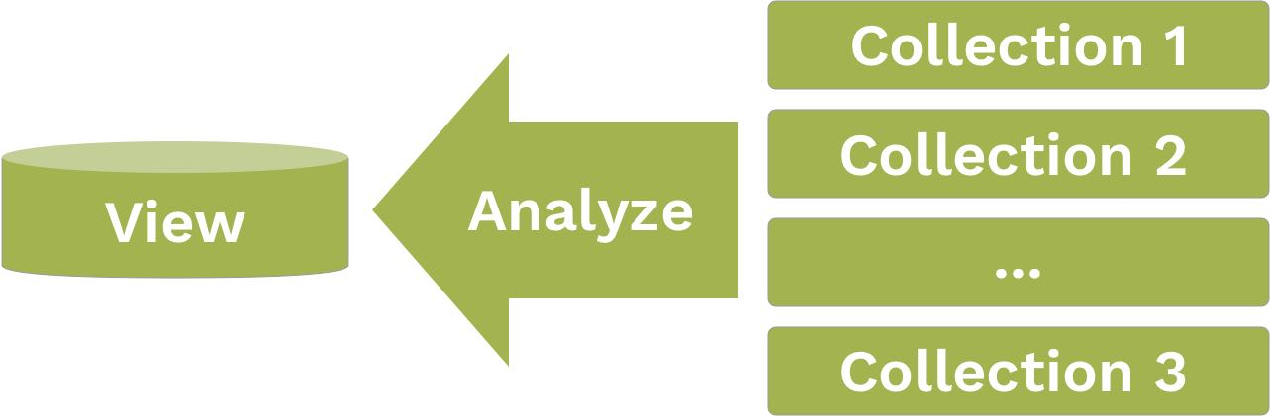
ArangoDB as a Search Engine
- Feature-Rich, Accurate & Ranked Search
- Provide Search for Everyone
- Find Relevant Results to Fuzzy Searches
- Search Across Multiple Sources
Perform complex searches including multiple attributes and data collections in ArangoDB. Unite your data sources in an ArangoSearch view for fast results to even complex queries.

Slide 18
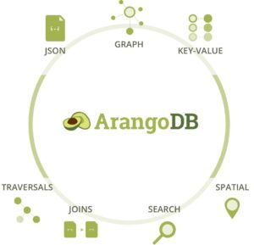
ArangoDB as a Search Engine
- Feature-Rich, Accurate & Ranked Search
- Provide Search for Everyone
- Find Relevant Results to Fuzzy Searches
- Search Across Multiple Sources
- Perform Multi-Model Graph Searches
Extend your ArangoSearch queries with graph, geo or relational-type aspects for even more fine-grained access to your data.
The flexibility of native multi-model combined with search is a powerful companion for many projects and simplifies your deployment stack

Slide 19
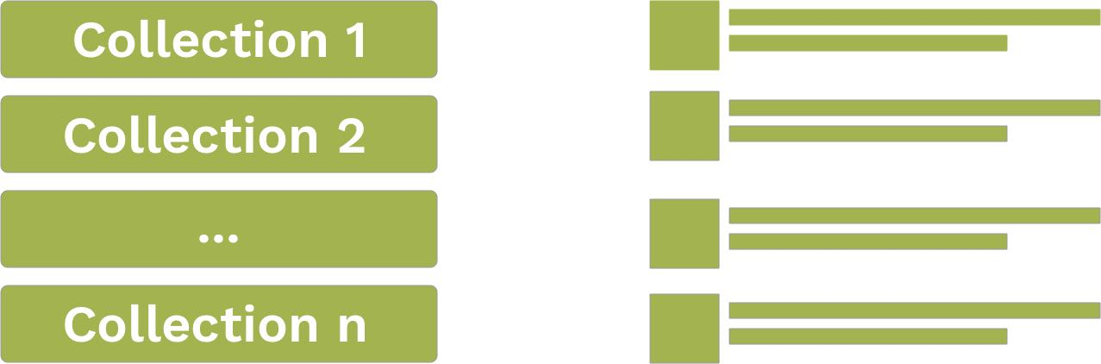
ArangoDB as a Search Engine
- Feature-Rich, Accurate & Ranked Search
- Provide Search for Everyone
- Find Relevant Results to Fuzzy Searches
- Search Across Multiple Sources
- Perform Multi-Model Graph Searches
- Index Everything
ArangoSearch supports schema-agnostic indexing for allowing maximum flexibility within your search queries. Combine even complex search across attributes & collections with all supported data models in ArangoDB.

Slide 20
Graph Database Basics
A graph consists of nodes, edges, and properties that represent the relationships within the data.
A graph database stores graphs and provides built-in functionality for query graphs.
In computing, graph is considered as an abstract data type which is really good at representing connections or relations

Slide 21
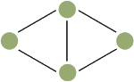
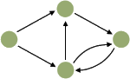
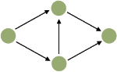
Graph Database Basics - Edges
Undirected – edges connect pairs of nodes without having a notion of direction
Directed – edges have a direction associated with them
Directed Acyclic Graph (DAG): edges have a direction and there are no loops. One example for a DAG is a tree topology.

Slide 22
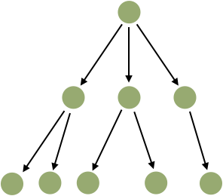
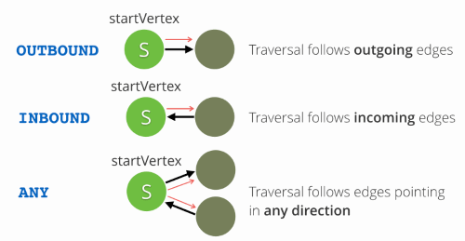
Graph Database Basics - Edges
Stored edges always have a direction _from one vertex _to another. Seen from a certain vertex, incoming edges are called inbound and outgoing edges outbound. During queries, the stored direction can be ignored by the actual query when deciding to follow any direction.

Slide 23
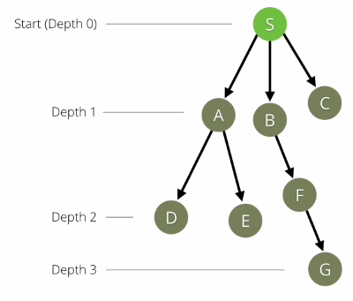
Graph Database Basics - Query Patterns
Graph databases offer specialized algorithms to analyze the relationships of data.Graph Database
The simplest algorithm is a so-called graph traversal. A graph traversal begins to traverse the graph beginning at a defined start vertex and ends at a defined depth with the end vertex.
When applying filters during a graph traversal on the properties of a vertex or an edge the pattern matching algorithm is being used.
You can also analyze the shortest distance between two given vertices or nodes. This query pattern is called shortest path.

Slide 24
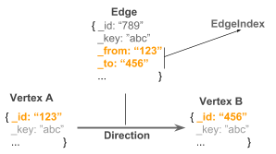
ArangoDB as a Graph Database
For each document, a unique _id attribute is stored automatically.
To build a relation (i.e., an edge) between two documents (i.e., vertices), both _id attributes are stored in a special edge document known as _from and _to attributes, forming a directed connection between two arbitrary vertices.
Edges are then stored in a special edge collection.

Slide 25
ArangoDB as a Graph Database
ArangoDB provides a broad spectrum of graph database features: graph traversals, shortest_path, pattern matching and distributed graph processing via Pregel.
Users can also take the result of a JOIN operation, geospatial query, text search or any other access pattern as a starting point for further graph analysis and vice versa – all in one query, if needed.

Slide 26
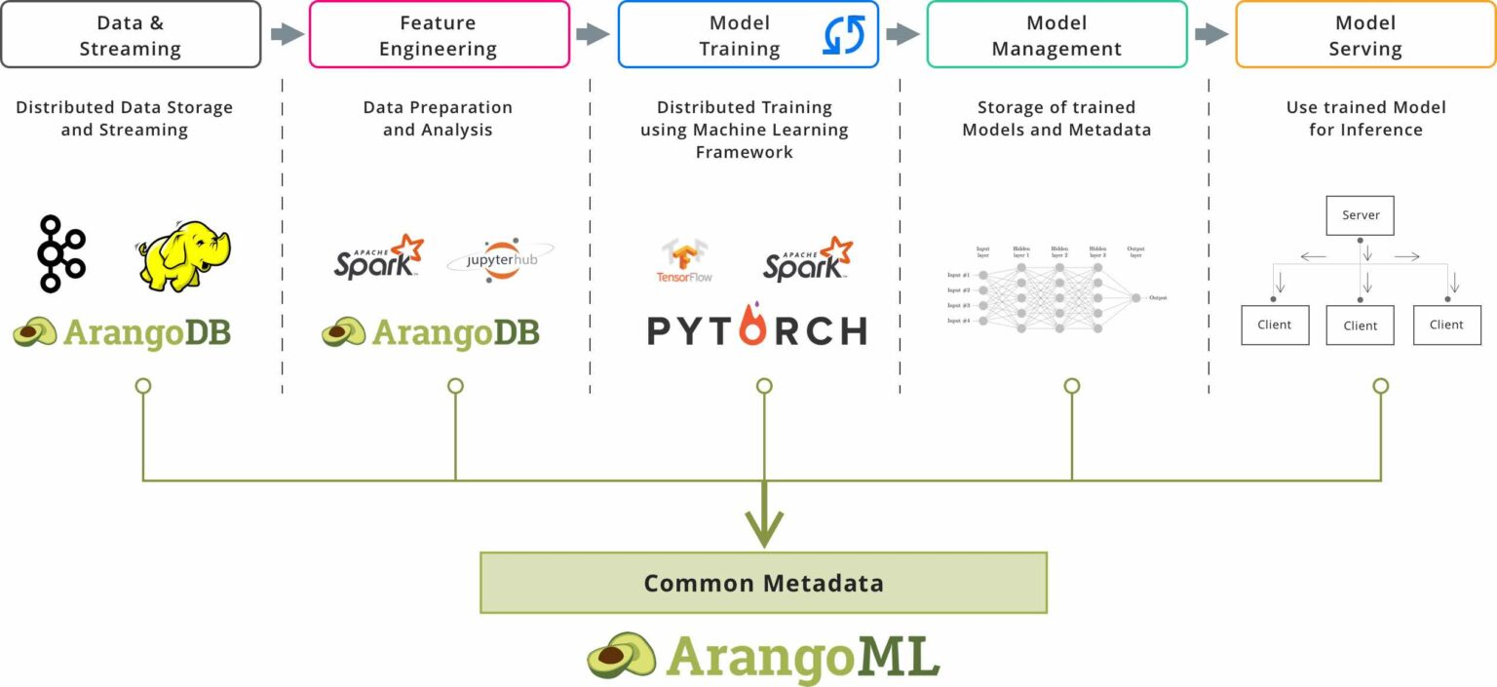
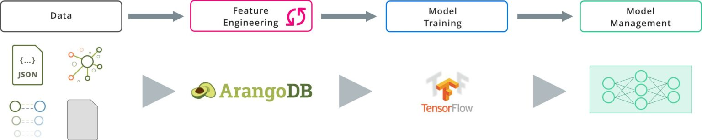
ArangoDB for Machine Learning
ArangoML for Machine Learning Infrastructure
When building a production-grade machine learning infrastructure, ArangoML provides support for common metadata storage across the entire machine learning lifecycle, and there enables reproducibility, monitoring, and auditing for your machine learning models.
Multi-Model-Powered Machine Learning
ArangoDB offers support for both analytics tasks and multi-model-powered machine learning. It is particularly helpful when dealing with a mixture of structured and unstructured data as ArangoDB can natively and efficiently manage different data models.

Slide 27
No dobra ale jak to ogarnąć?

Slide 28

Arango Query Language (AQL)
Jeden by wszystkimi rządzić

Slide 29
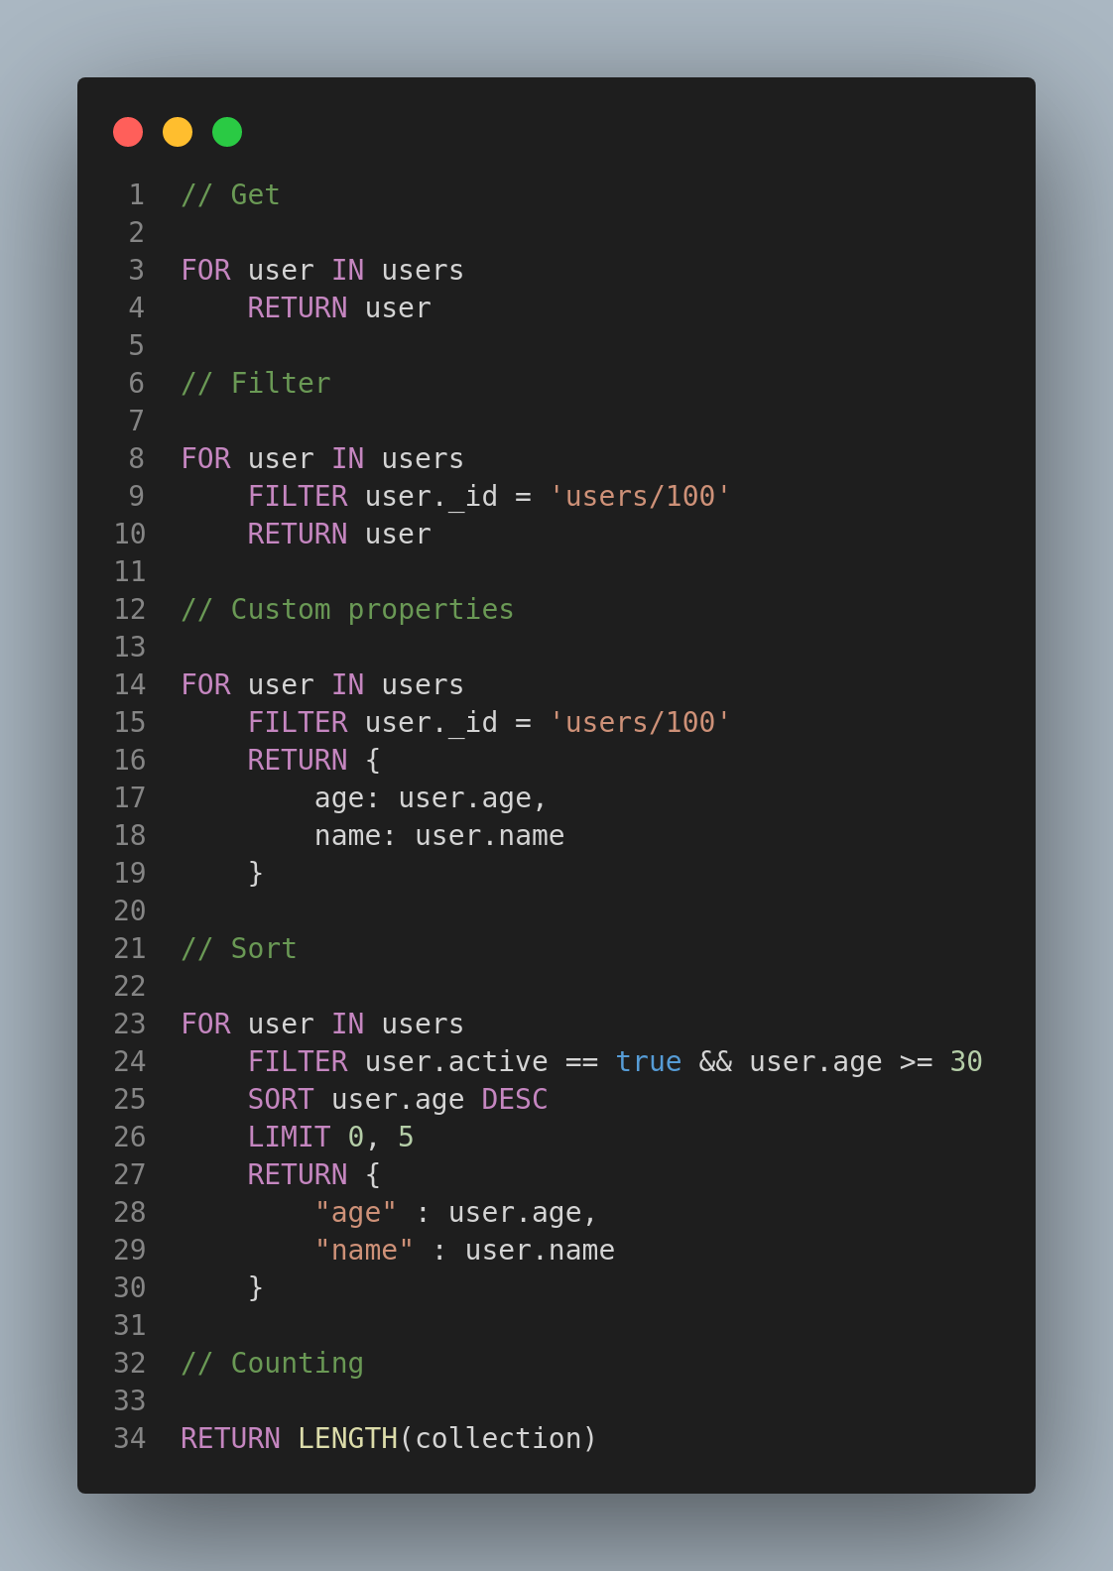
AQL - Basics

Slide 30
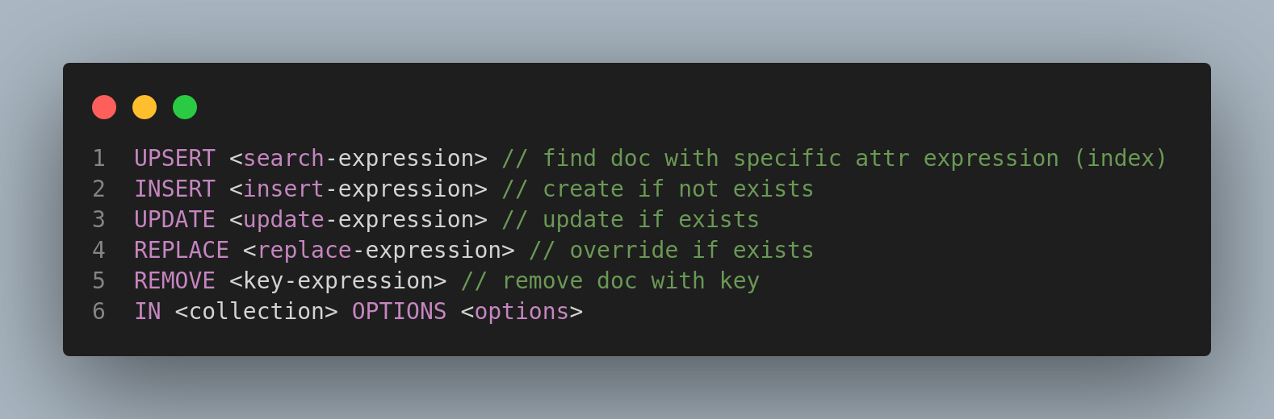
AQL - Modifications

Slide 31
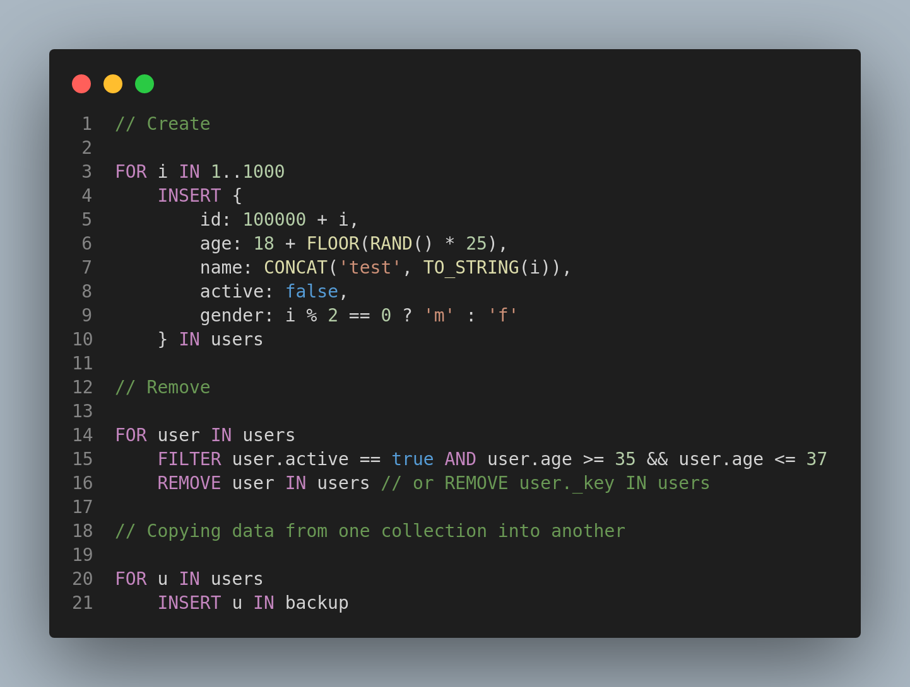
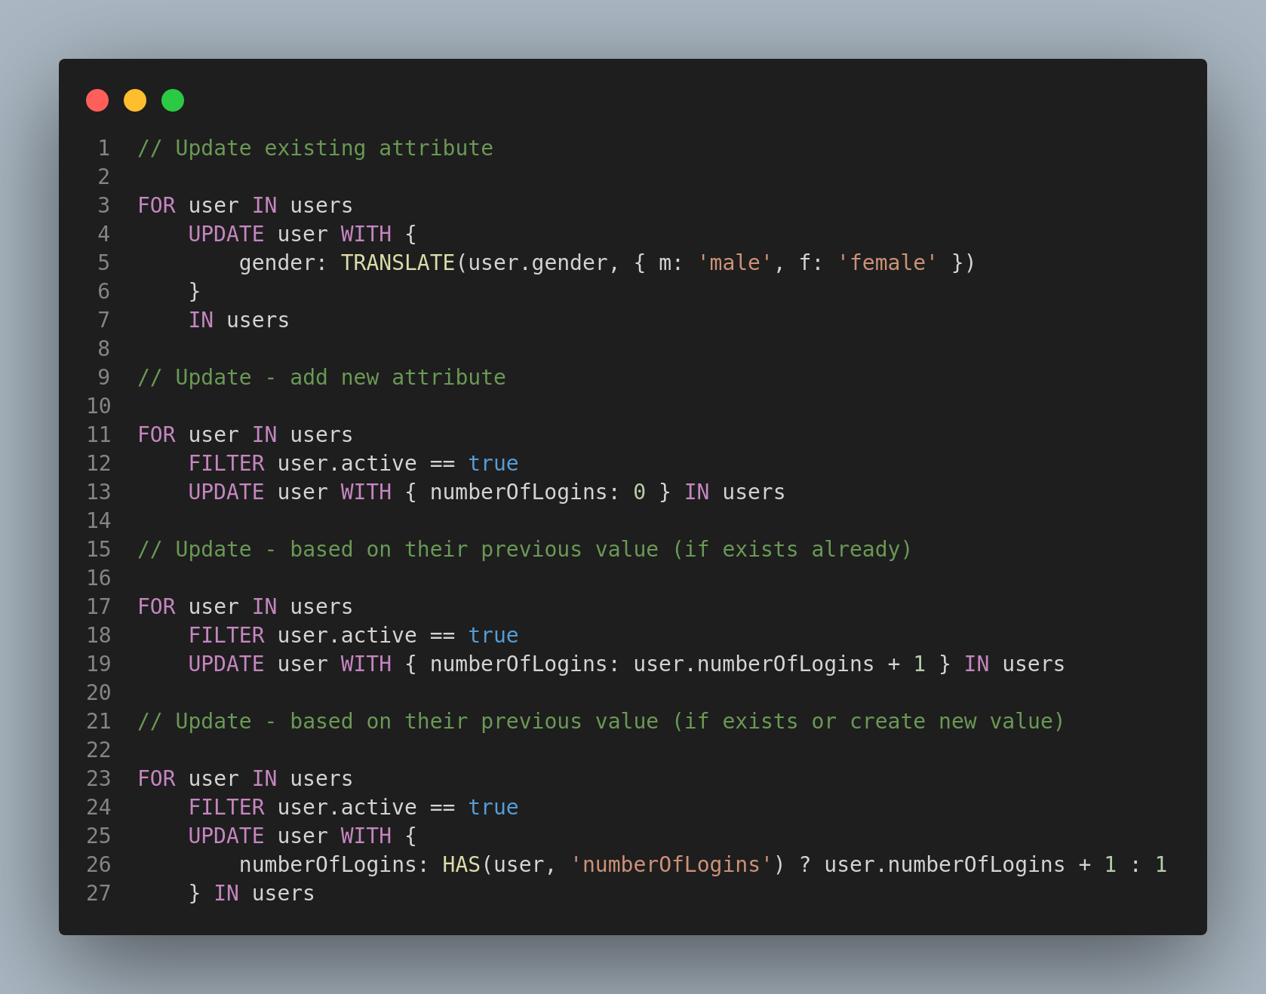
AQL - Modifications

Slide 32
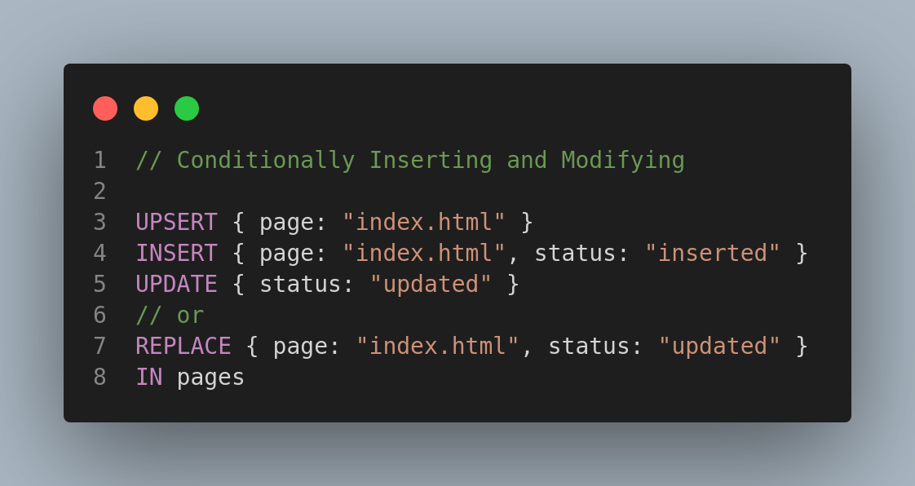
AQL - Conditional Modifications

Slide 33
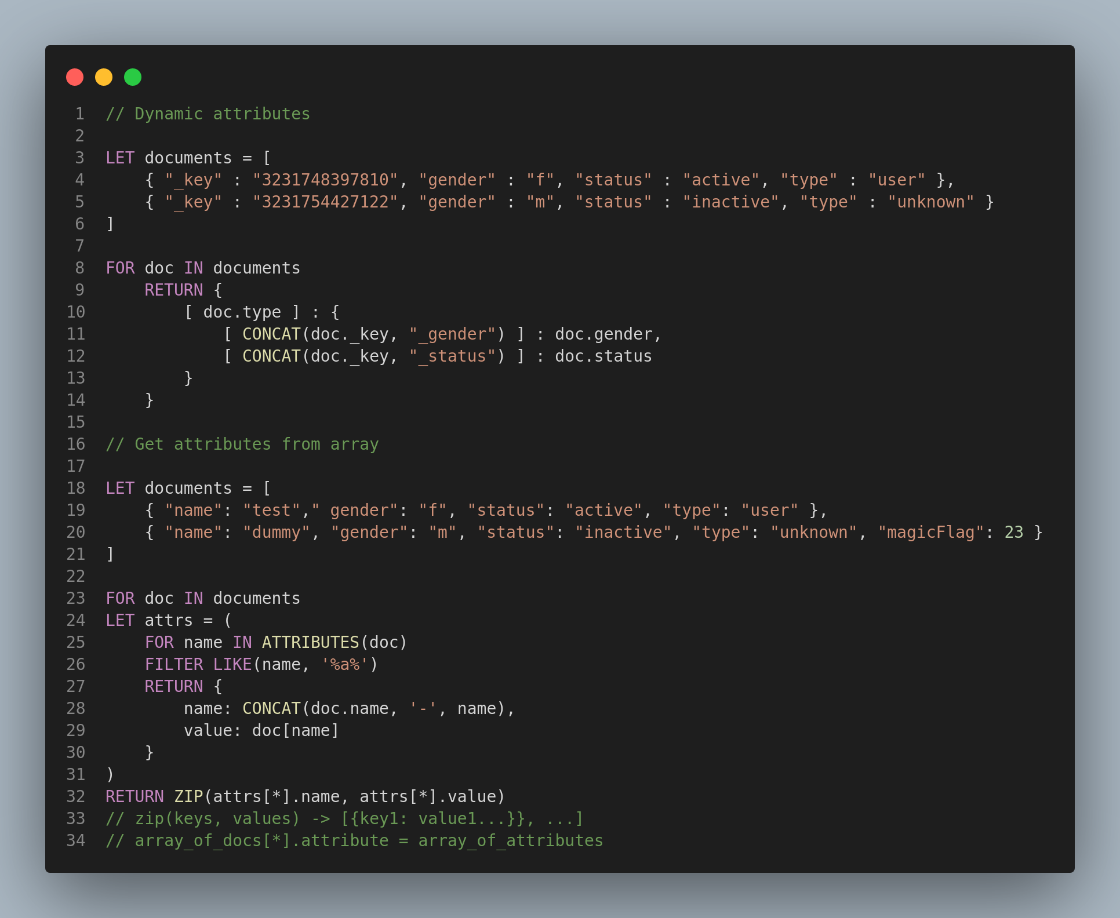
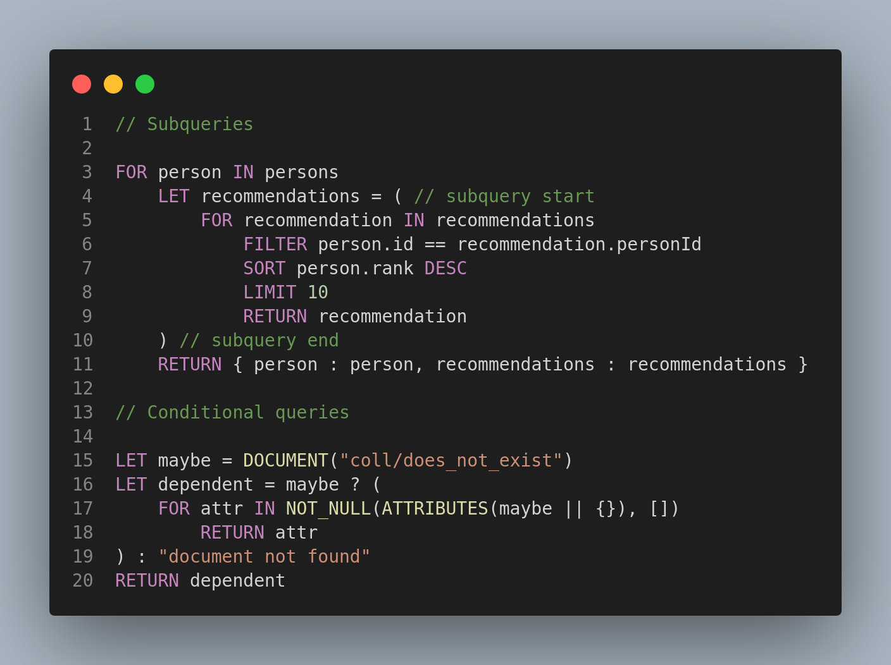
AQL - Advance

Slide 34
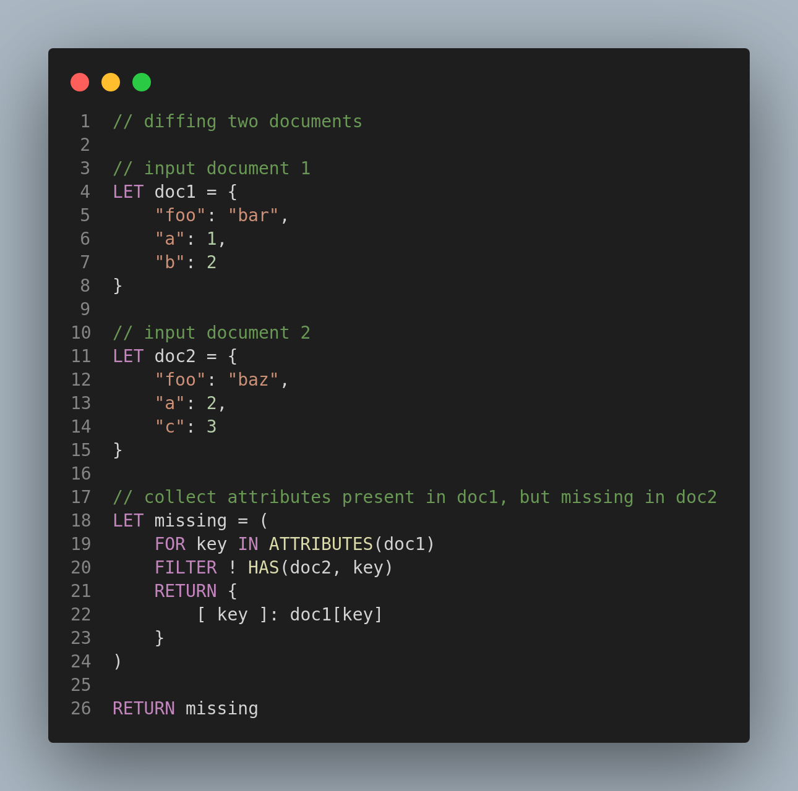
AQL - Advance

Slide 35
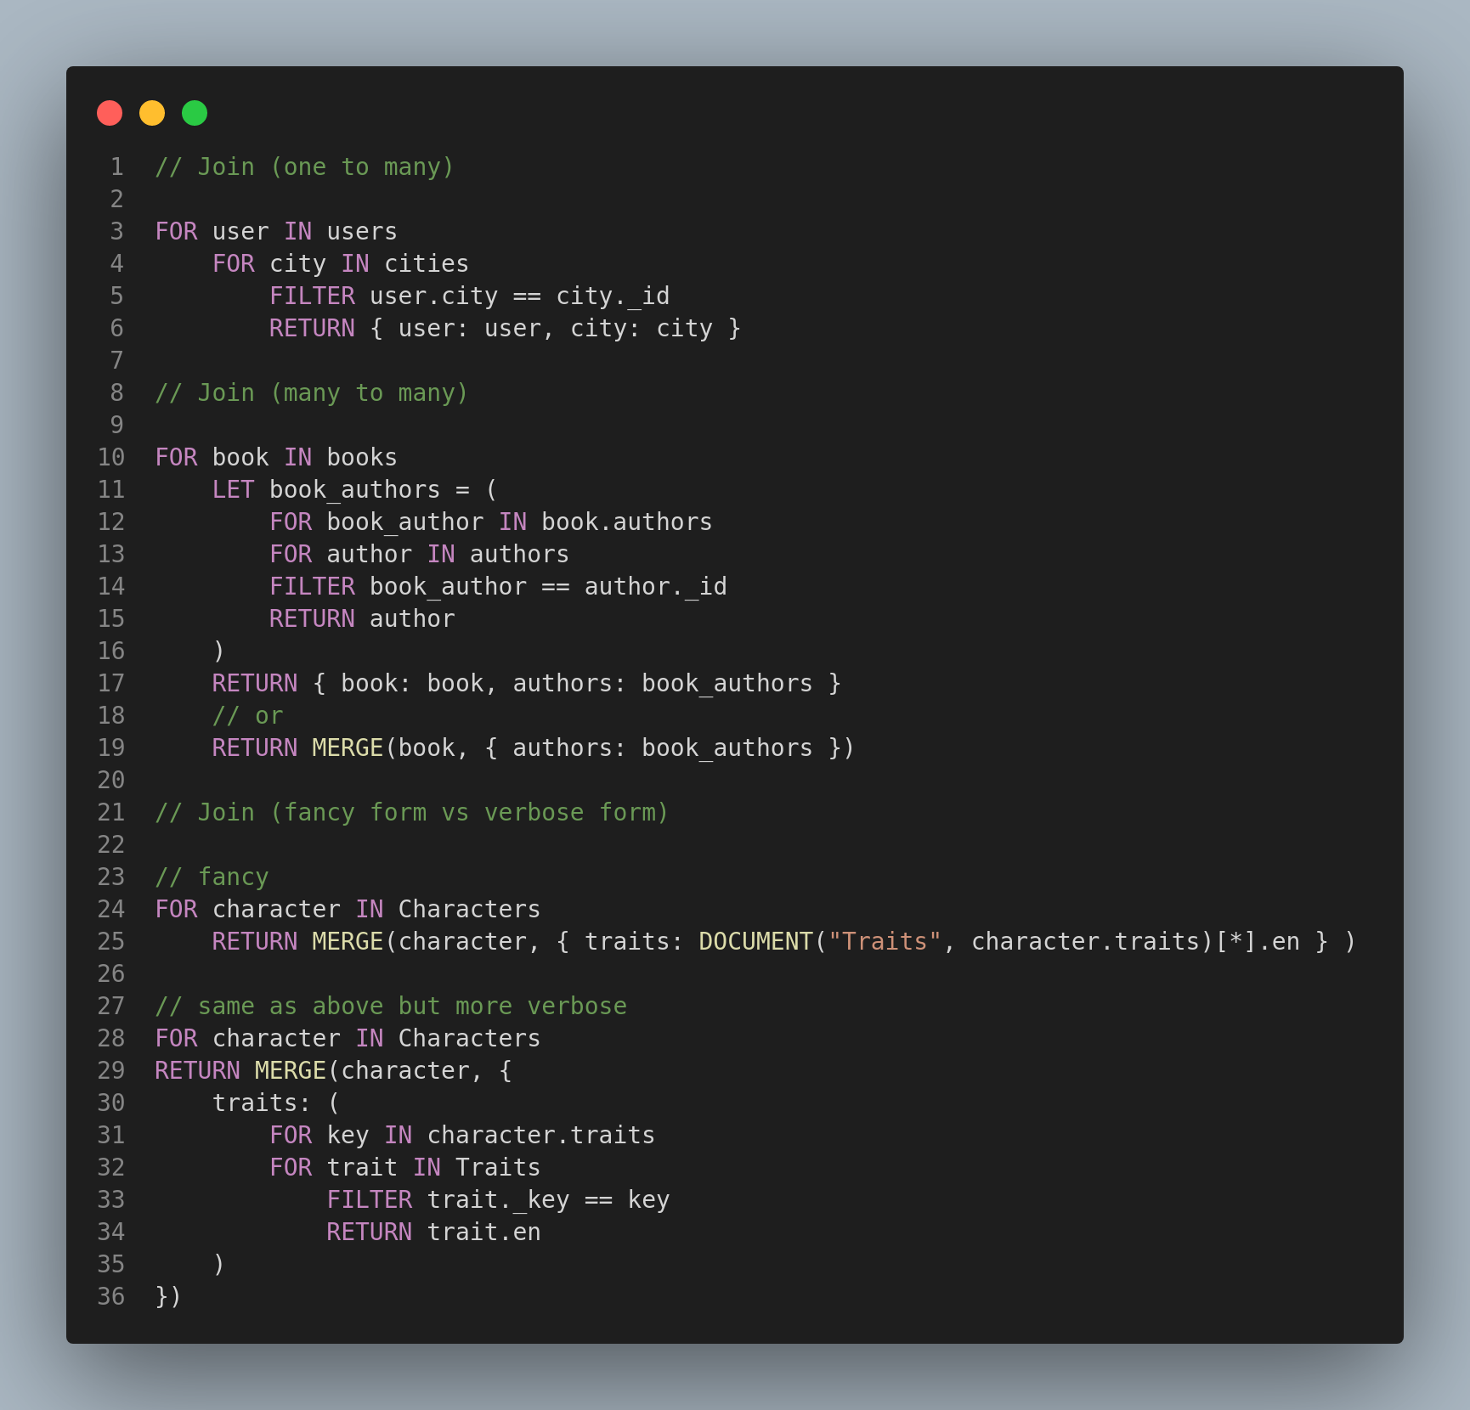
AQL - JOINS

Slide 36
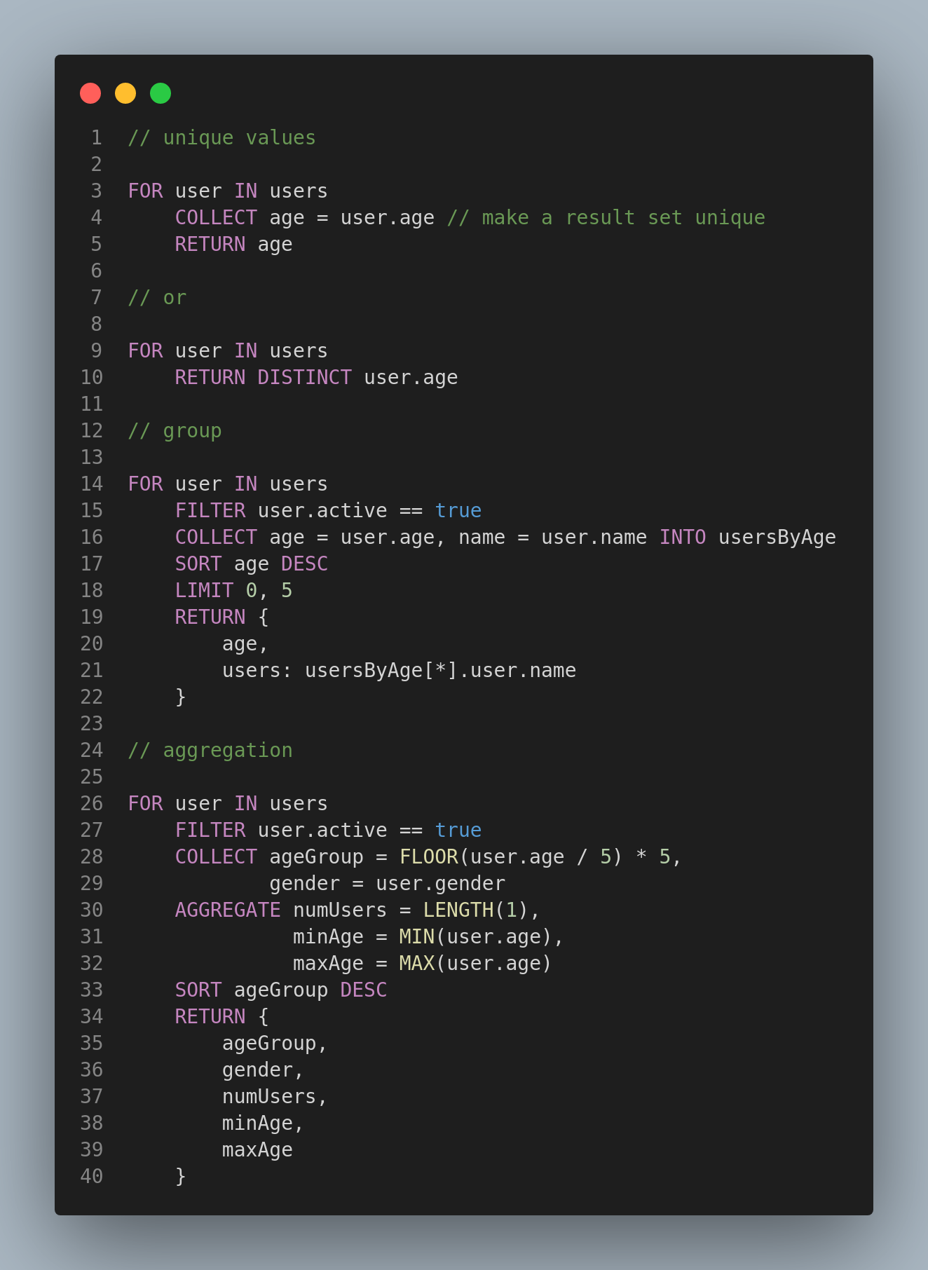
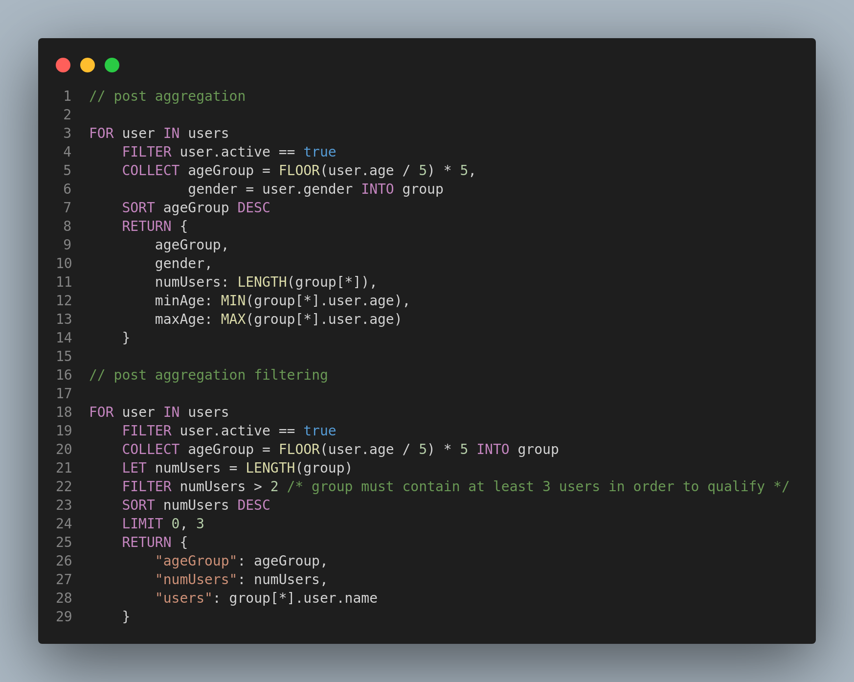
AQL - Agregations

Slide 37
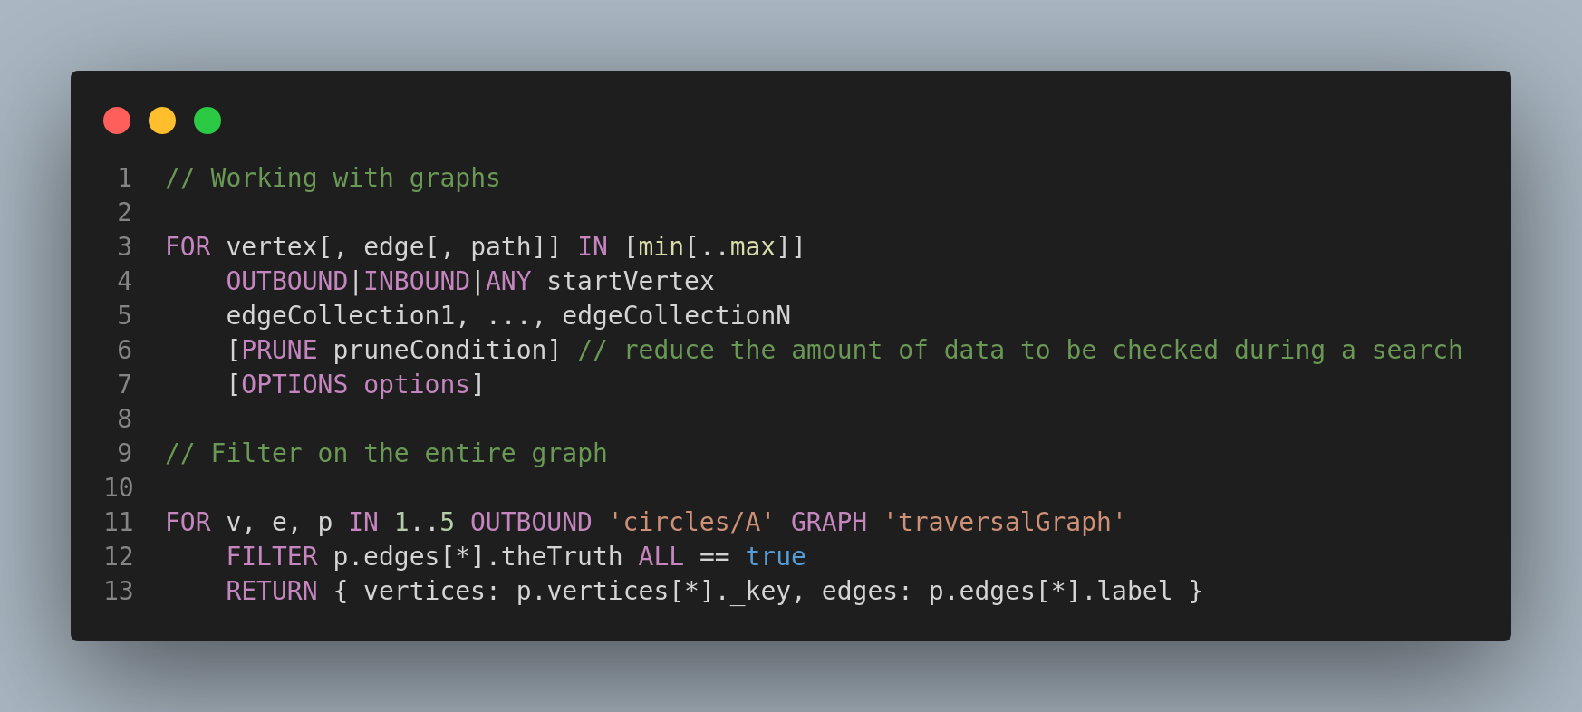
AQL - Graphs

Slide 38
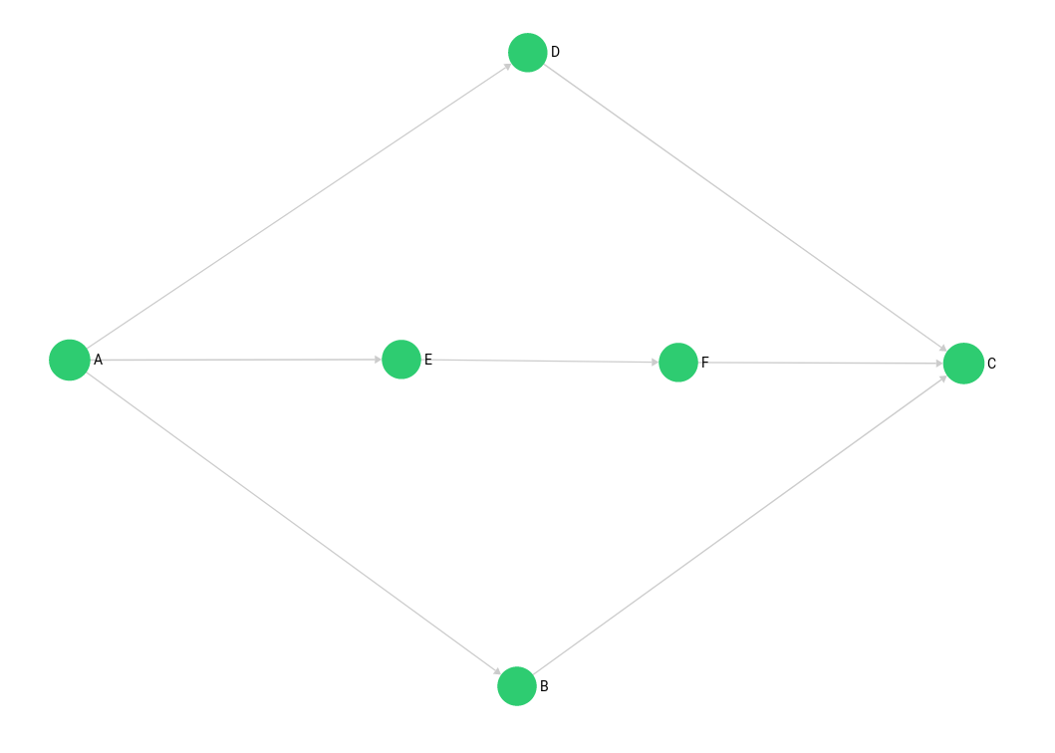
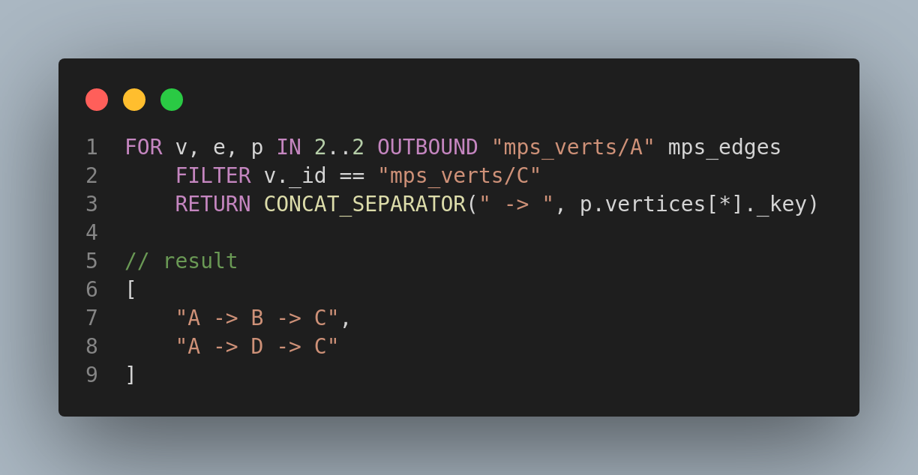
AQL - Graphs

Slide 39
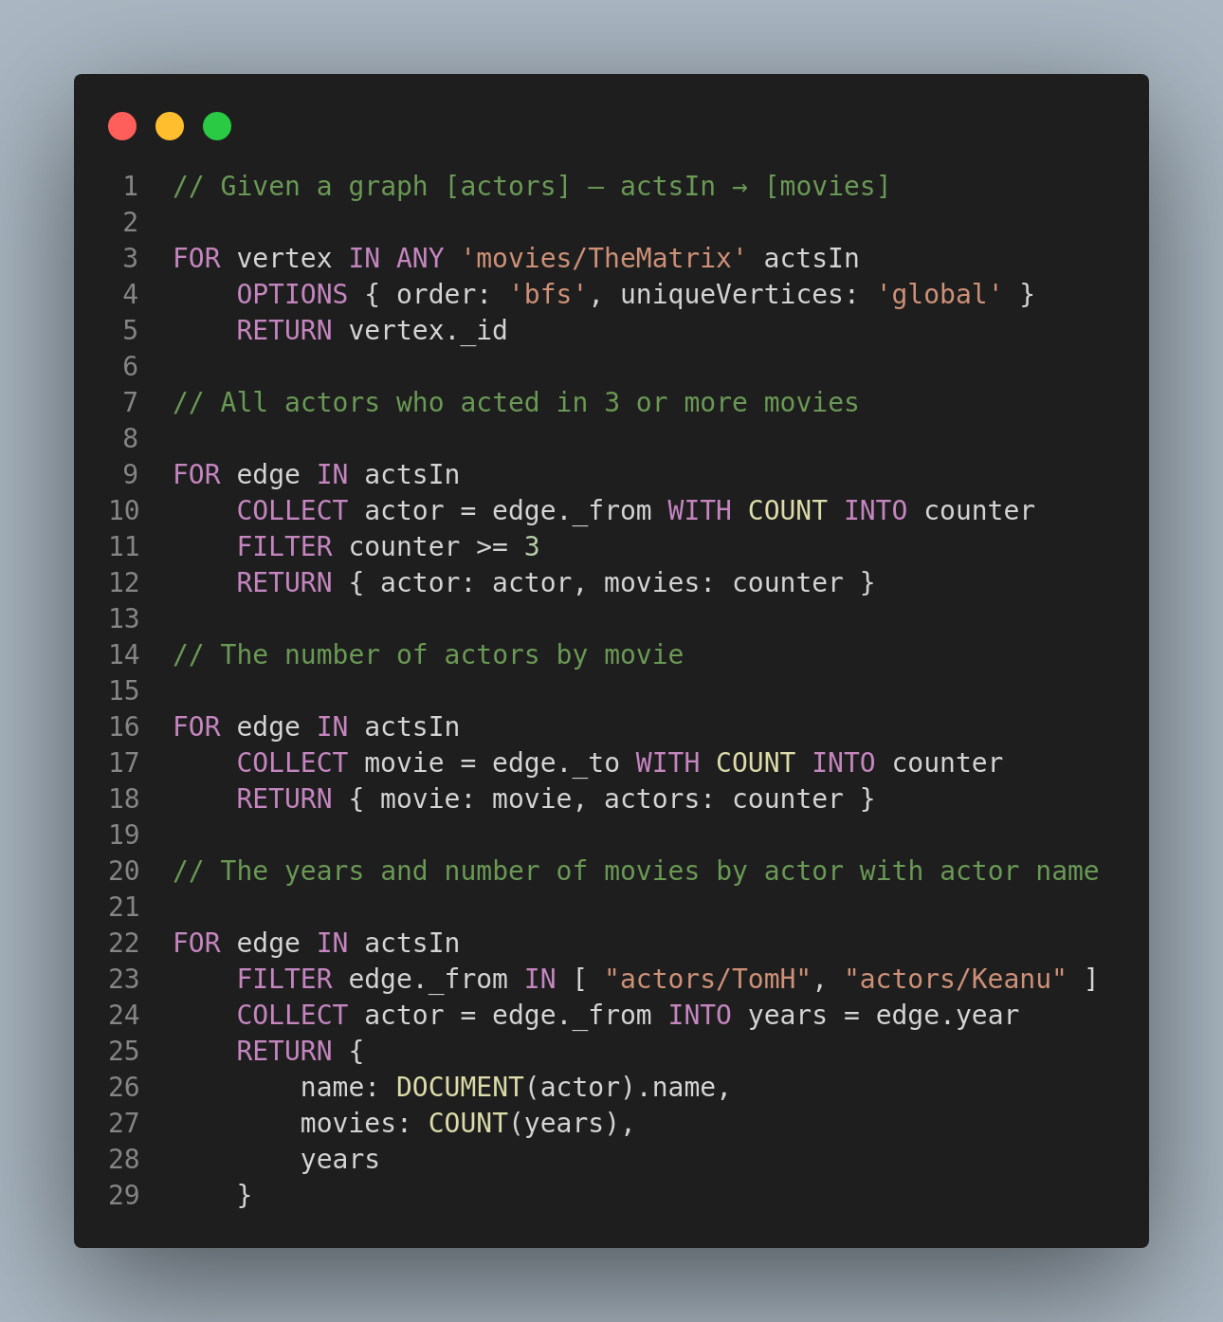
AQL - Graphs

Slide 40
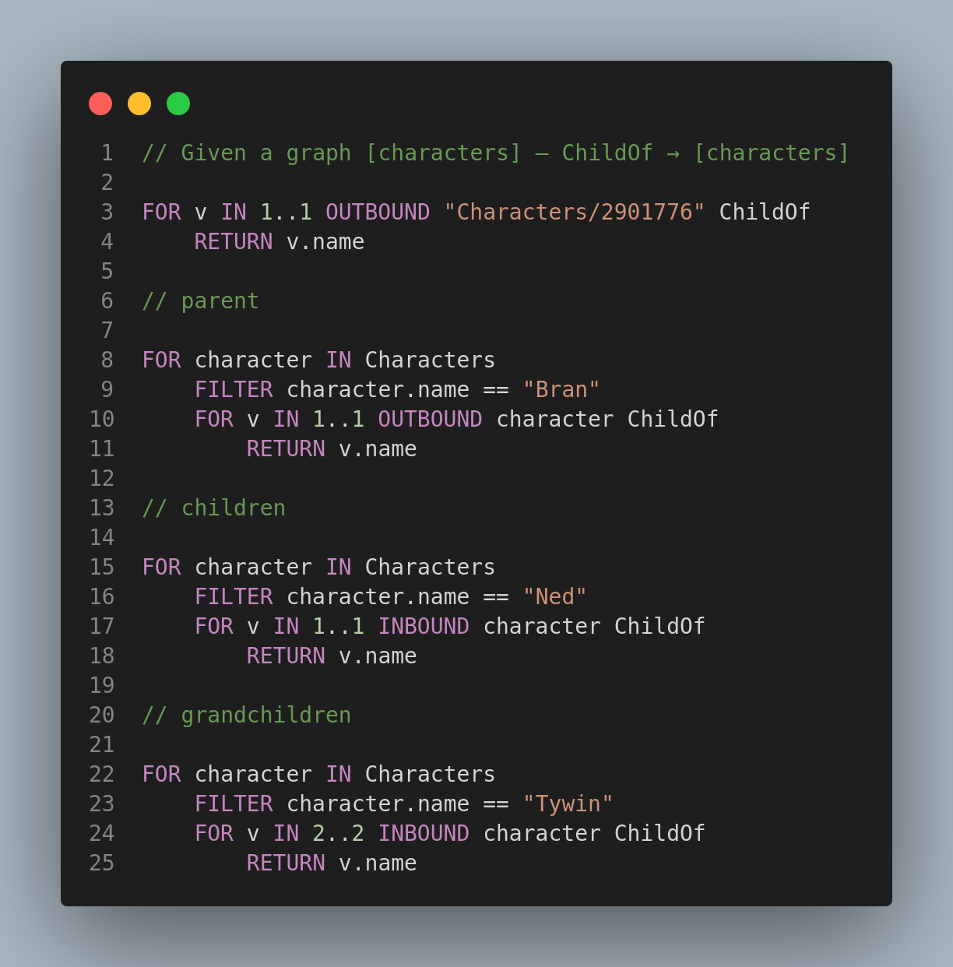
AQL - Graphs

Slide 41
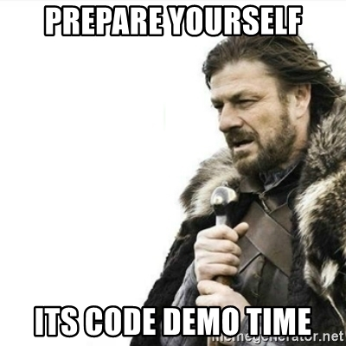

Slide 42
ArangoDB vs Other databases

Slide 43
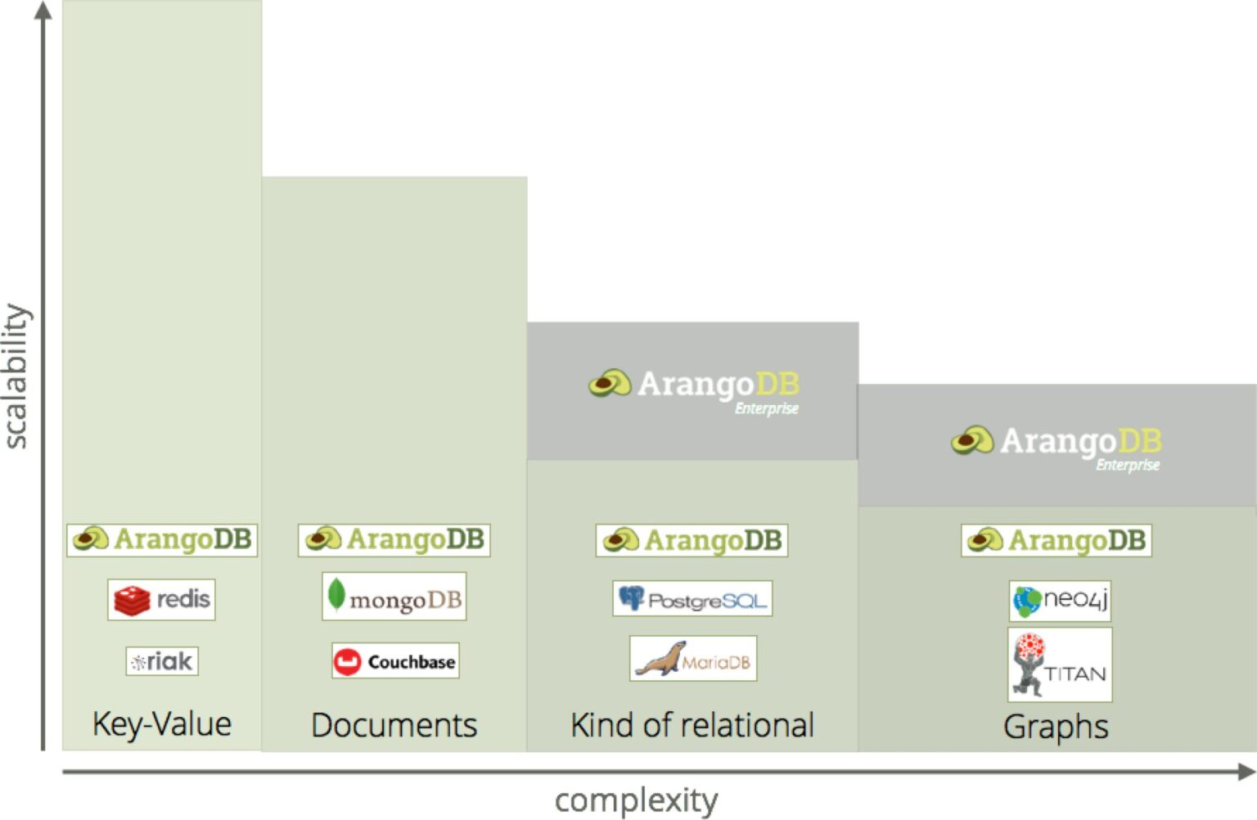
ArangoDB vs MongoDB - What you can't do with MongoDB
Multi-model: MongoDB is a single-model document database. It does not support any other data models.
Joins: Using and scaling joins over different collections and instances is not supported by MongoDB (scalability depends on the use case).
Declarative Query Language: MongoDB uses JSON syntax for queries. It does not support a declarative query language. By contrast, ArangoDB developed its own SQL-like query language (AQL) for complex queries, allowing the combination of access patterns in a single query
Complex Transactions: Use complex transactions to span multiple documents and collections, or to run aggregations. Complete Isolation in the cluster available

Slide 44
ArangoDB vs Neo4j - What you can't do with Neo4j
Multi-model: Neo4j is a single-model graph database. It does not support any other data models.
Scalability: Scaling graph collections over many instances is technically a hard task. But with ArangoDB it is possible to minimize the network-hop problem and run queries highly efficient even against distributed graph data. Neo4j does not support this.
Performance: In ArangoDB you can use the same collection for a graph and for a document query without performance losses. ArangoDB showed competitive or even better performance.
Operational costs: ArangoDB can be used for a broad range of use cases and reduces the number of storage products in your technology stack.

Slide 45
ArangoDB vs Cassandra - What you can’t do with Cassandra
Multi-model: Cassandra is a partitioned row-store database. It does not support any other data model.
Unified Query Language: ArangoDB Query Language (AQL) supports all three data models (k/v, document, graph) with their respective data access patterns (Projections, Joins, Traversals, more). In addition, querying special data types like text or geo-spatial is natively supported by AQL.
Joins: Also various join operations are supported natively in AQL. ArangoDB even supports join operations at scale with the Satellite Collection feature. With Cassandra, these operations are not possible natively and have to be done client-side with all its security and performance impacts.
Complex Transactions: Cassandra does not support ACID transactions.
Lower TCO: Knowing a multi-model database means applying the same knowledge to diverse use cases and lets developers move much faster.

Slide 46
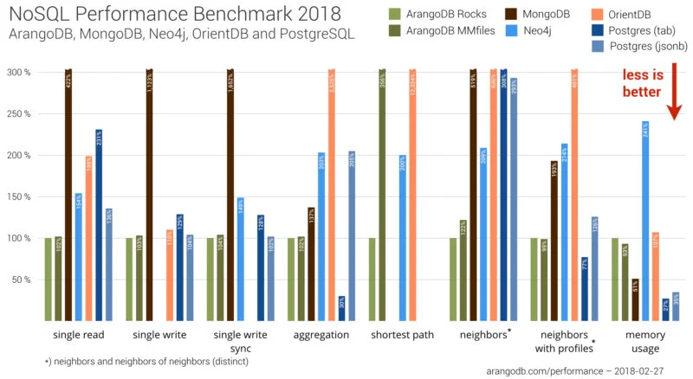
Performance Benchmark of ArangoDB
Our complete benchmark series is open source. It investigates how databases perform in some of the most common operations, such as single read/writes, single write sync, aggregation, shortest paths, neighbors, neighbors with profiles, and memory usage.

Slide 47
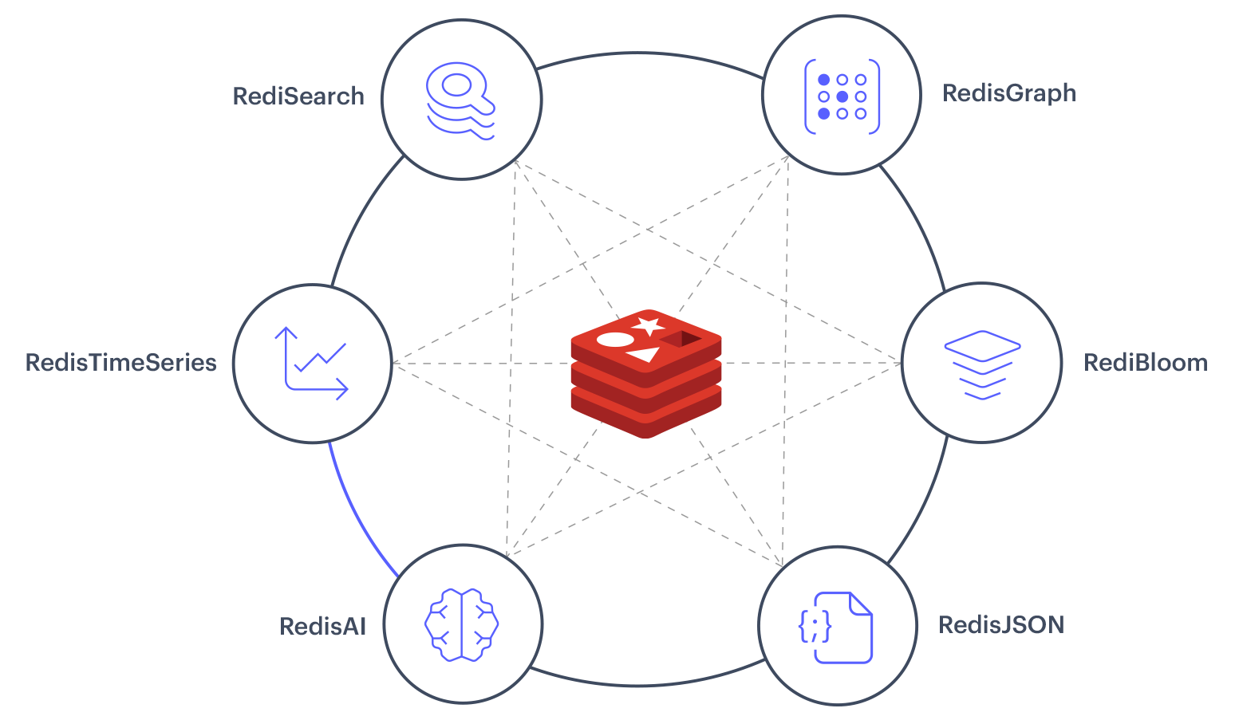
Redis as multi-model database

Slide 48
When to use + Advantages
Consolidation As a native multi-model database, ArangoDB minimizes the components that you need to maintain, reducing the complexity of the technology stack for your application or usage.
Simplified Performance Scaling ArangoDB scales both vertically and horizontally, and if your performance needs decrease, you can just as easily scale down your back-end system to save on hardware and operational requirements.
Reduced Operational Complexity Polyglot Persistence is about choosing the right data model for the right job. A native multi-model database allows you to have polyglot data without the complexity, but with data consistency on a fault tolerant system.
Strong Data Consistency With ArangoDB, a single back-end manages your different data models with support for ACID transactions. ArangoDB provides strong consistency on a single instance and atomic operations when operating in cluster mode.
Fault Tolerance Deploying and maintaining such systems requires deep expertise of several different technologies and technology stacks. Moreover, bringing together multiple subsystems that were designed to run independently imposes significant engineering and operational costs.
Lower Total Cost of Ownership Each database technology you use needs ongoing maintenance, patches, bug fixes and other modifications delivered by the vendor. Each new update has to be tested by a specialized team member and tested for their overall fit into the current system.
Transactions It is a real challenge to provide transactional guarantees across multiple machines and few NoSQL database provide these guarantees. As a native multi-model database, ArangoDB requires transactions to ensure data consistency. ArangoDB provides strong consistency on single instances and atomic single document operations when running in cluster mode.
Staying flexible in developing new ideas
In situations when developing a new product or service, you might not know all your requirements for at the outset. Changes in your product or the need for new features can lead to changes in your data model.With a multi-model database, you are able to easily react to those changes. You can apply your knowledge of one technology to several use cases and requirements.No need to learn a new technology or build a new tech-stack.
Developing software as a team
ArangoDB enables teams to cooperate across use cases. For instance, one team starts work on an application that requires a Document database. In the course of development, members of this team learns tips and tricks about the usage of ArangoDB. Another team begins work on a Graph database.Both teams can exchange their experience with ArangoDB and optimize their usage. This shortens the learning curve, deepens teamwork and reduces the time to get your solutions live.
Combining different data models in one query
No need to build two or three tech-stacks to support your application. These create risky connections between different single-model databases. Instead, ArangoDB is designed it easier to develop modular applications.

Slide 49
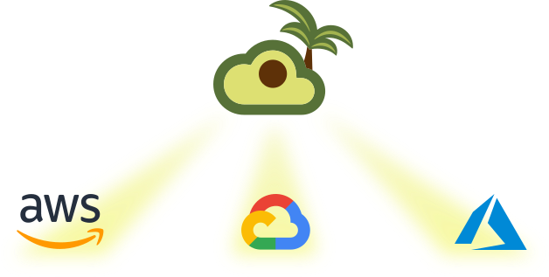
Opcja dla leniwych - ArangoDB Oasis (Cloud)
Key features
- Fully managed (Graph database, Document store, Search engine, Native multi-model)
- Highly Secure (Access Control Policies, Always-on Encryption, IP Allowlisting, Snapshot Backups)
- Elastic Scale (OneShard Clusters, Sharded Clusters, Multi-Tenant Ready, Organized Teamwork)
- Oasis-as-code (Continuous integration, Automatic scaling, Oasisctl, Terraform)
- Expert Support

Slide 50
Przydatne linki
ArangoDB Documentation
SQL / AQL - Comparison
Drivers (Java, GO, C#, itd.)
Python Driver for ArangoDB
The ArangoDB Operator for Kubernetes – Stateful Cluster Deployments in 5min

Slide 51

Podsumowanie

Slide 52

Jak jesteś od wszystkiego to jesteś do niczego
Niektórzy mówią
Ale czy czegoś wam to nie przypomina???

Slide 53

Dziękuje za uwagę

